Slide 1

The Largo Bay Community Triptych
A community textile project

Slide 2
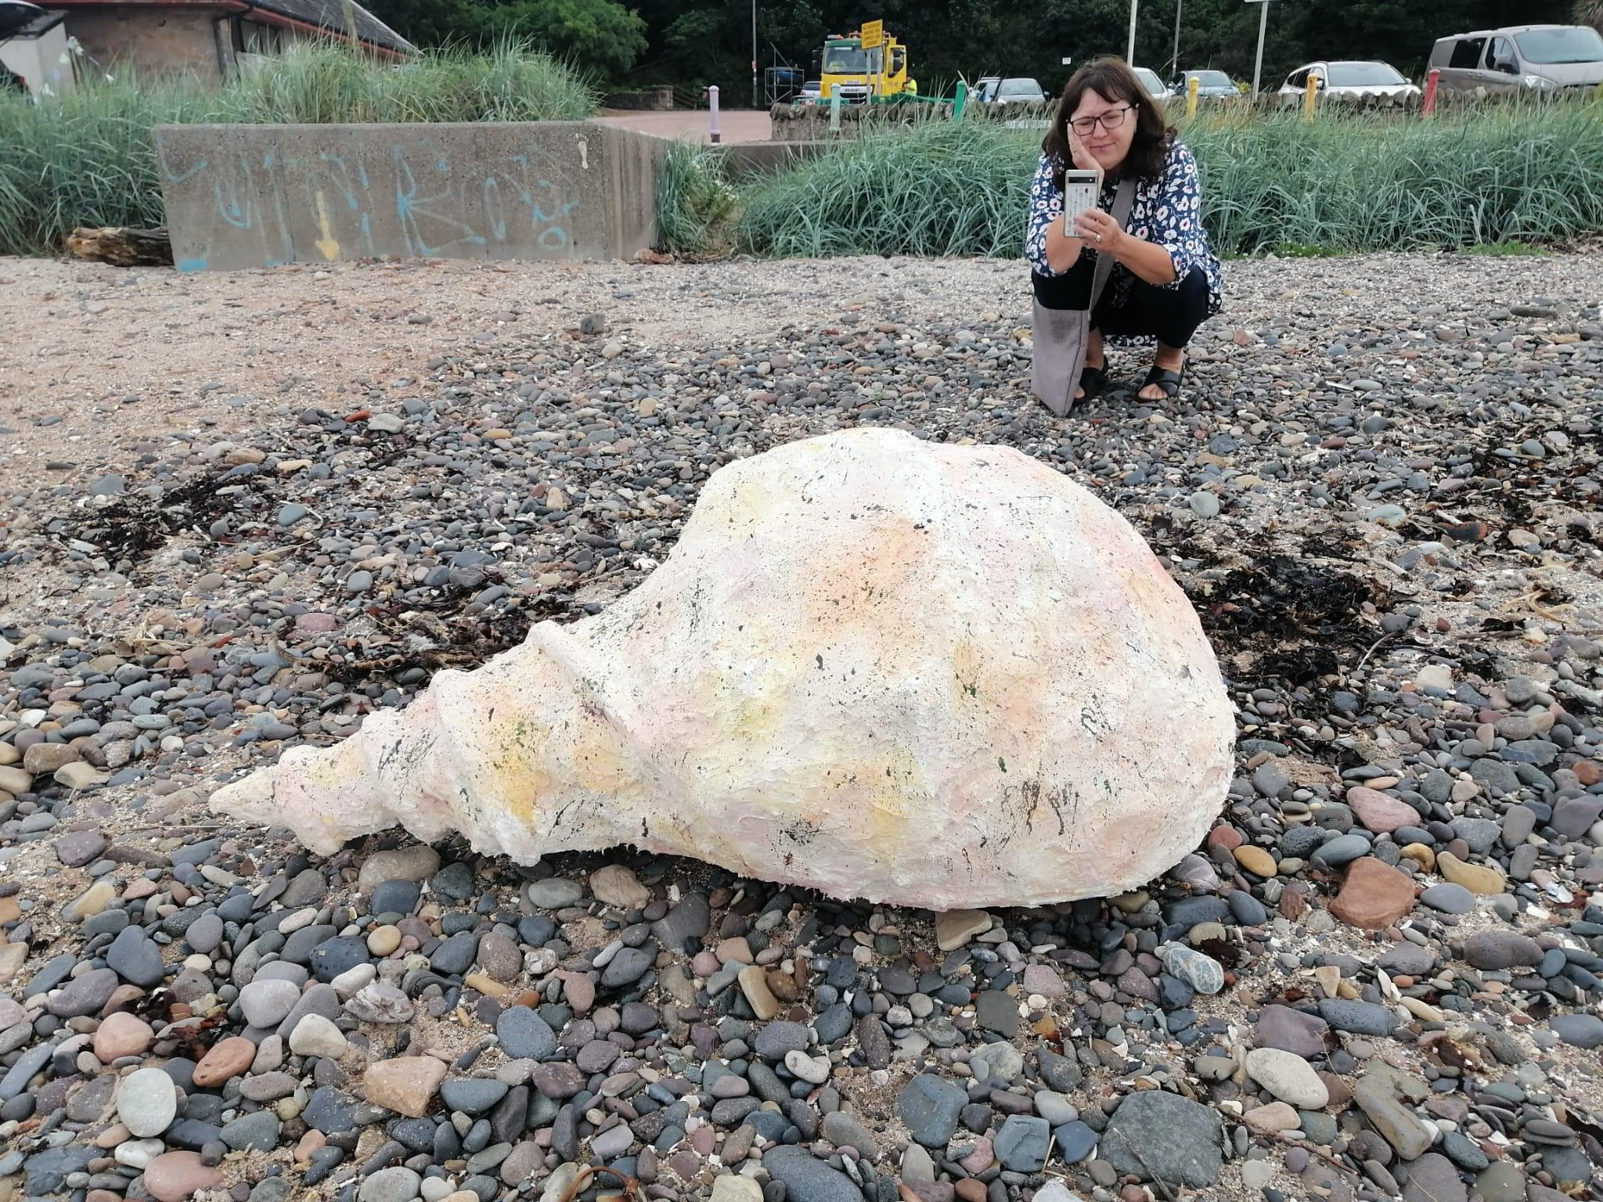
Art & Education Outreach: Edinburgh Shoreline 100 Species

Slide 3
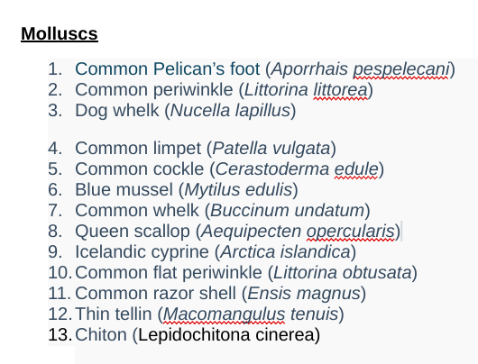
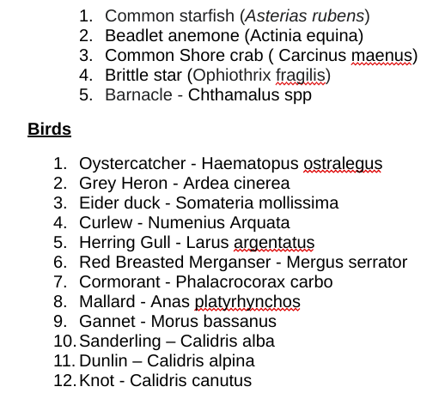
100 Species: Firth of Forth

Slide 4
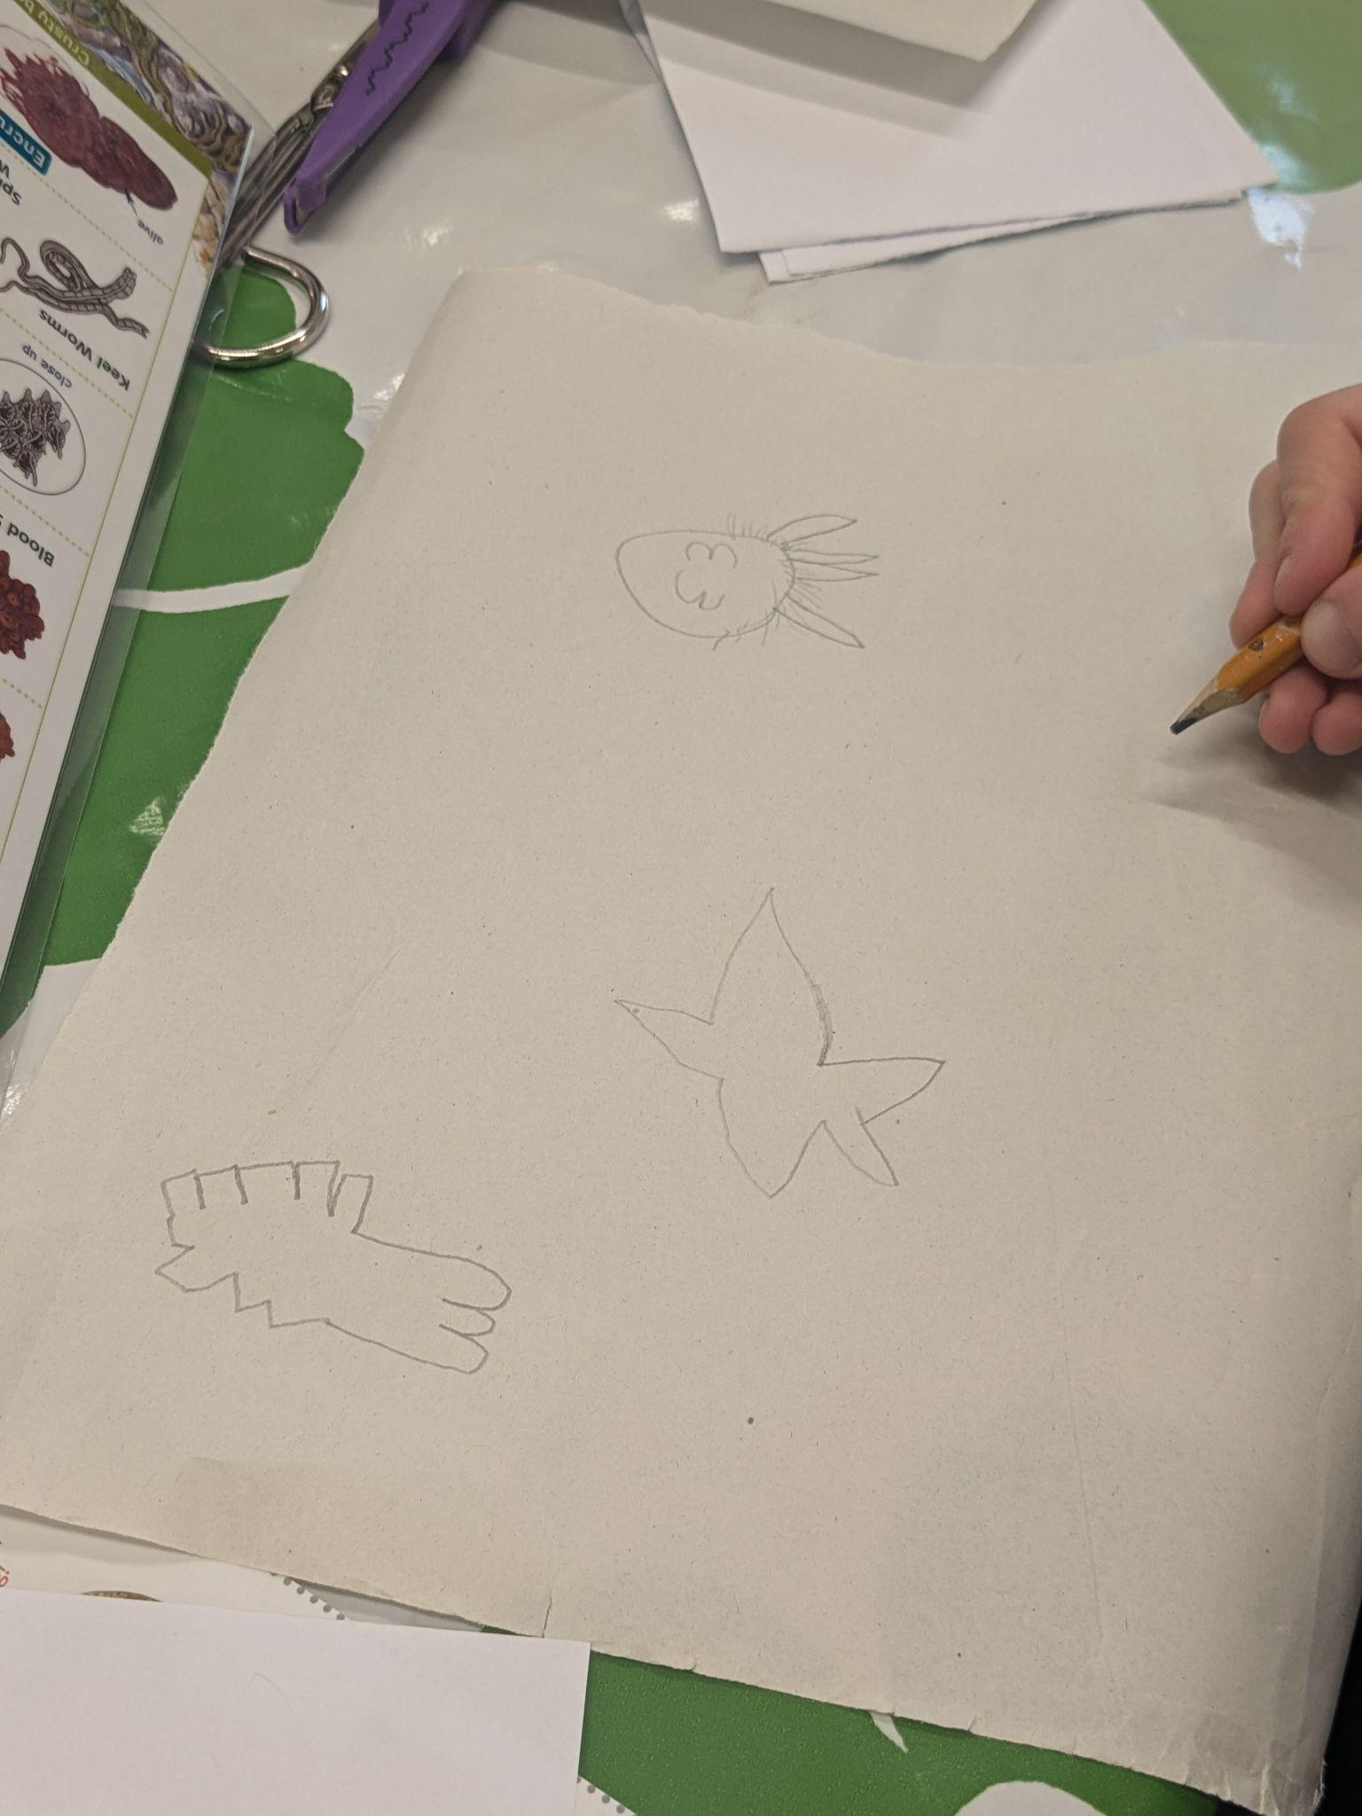
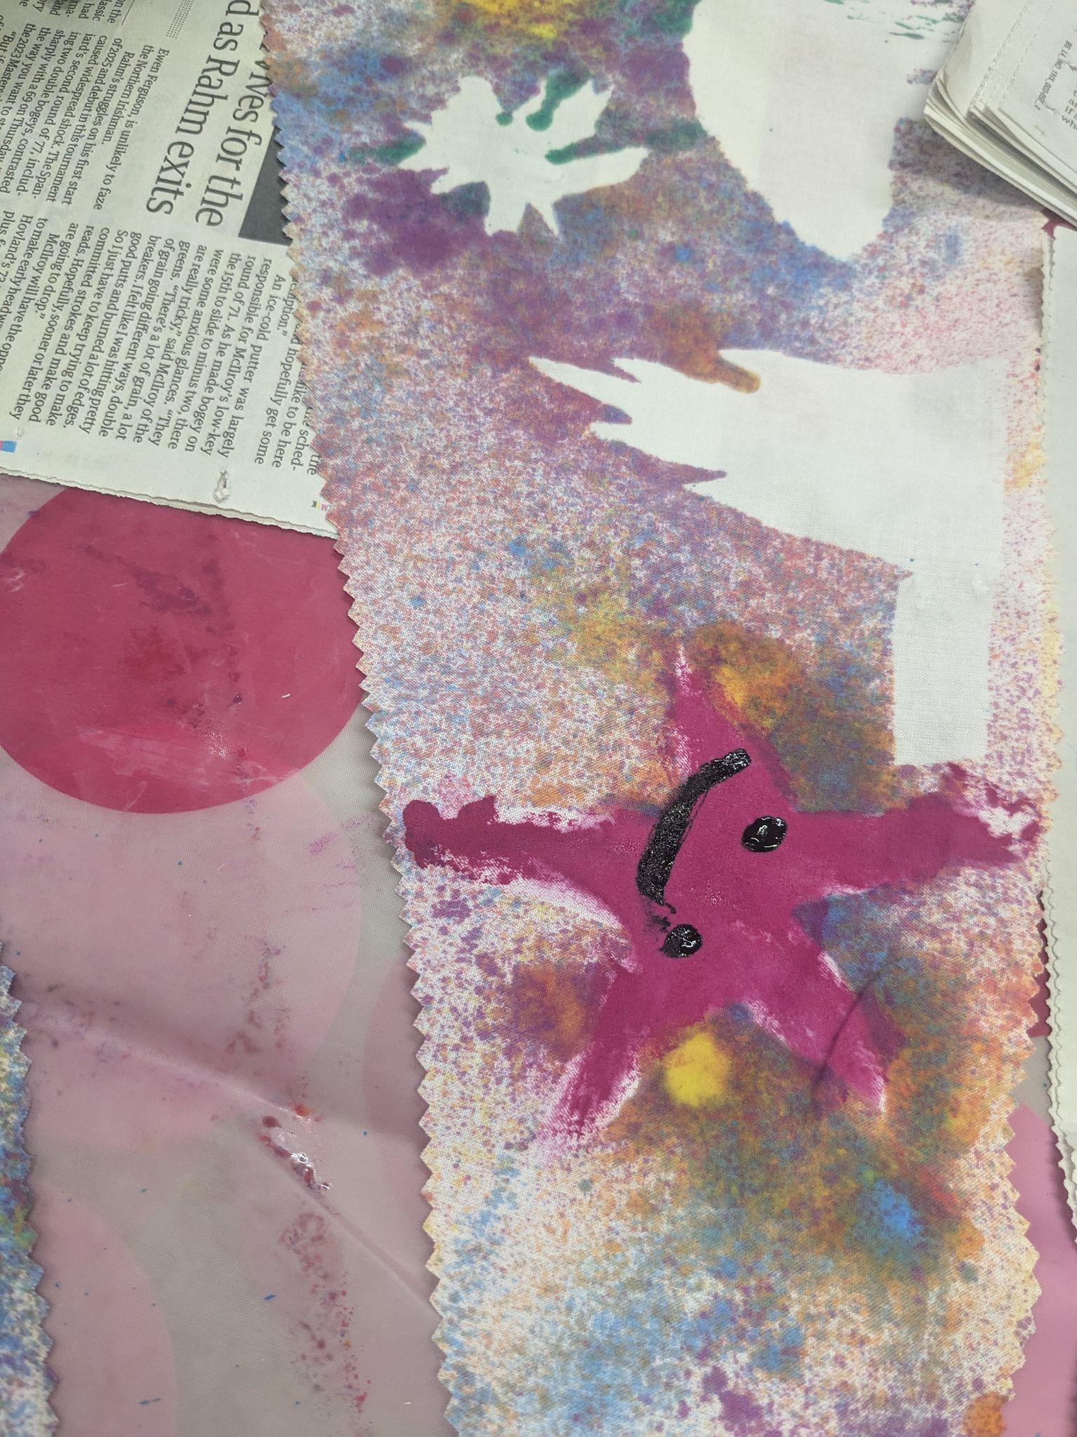
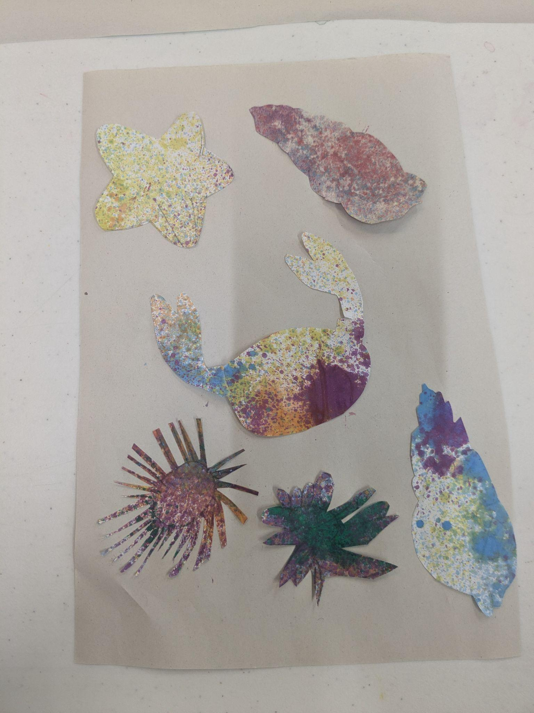
Art & Education Outreach: Science Saturdays

Slide 5
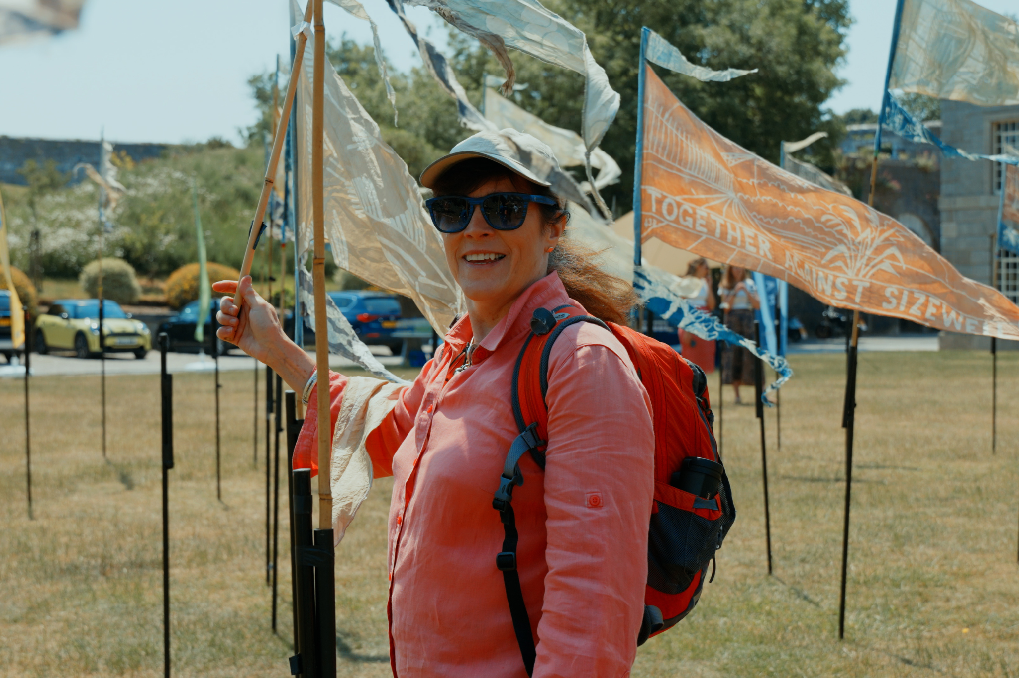
Kinetika - Beach of Dreams

Slide 6
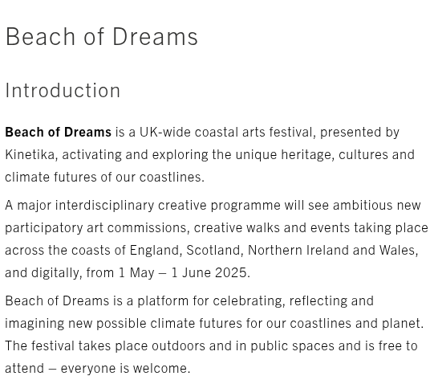

Slide 7
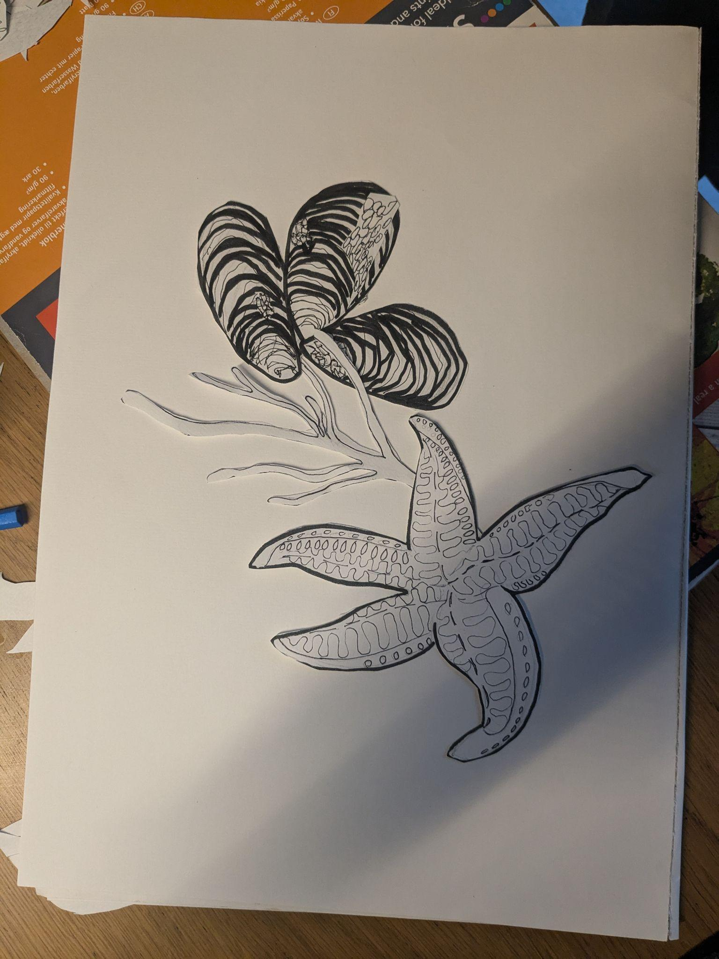
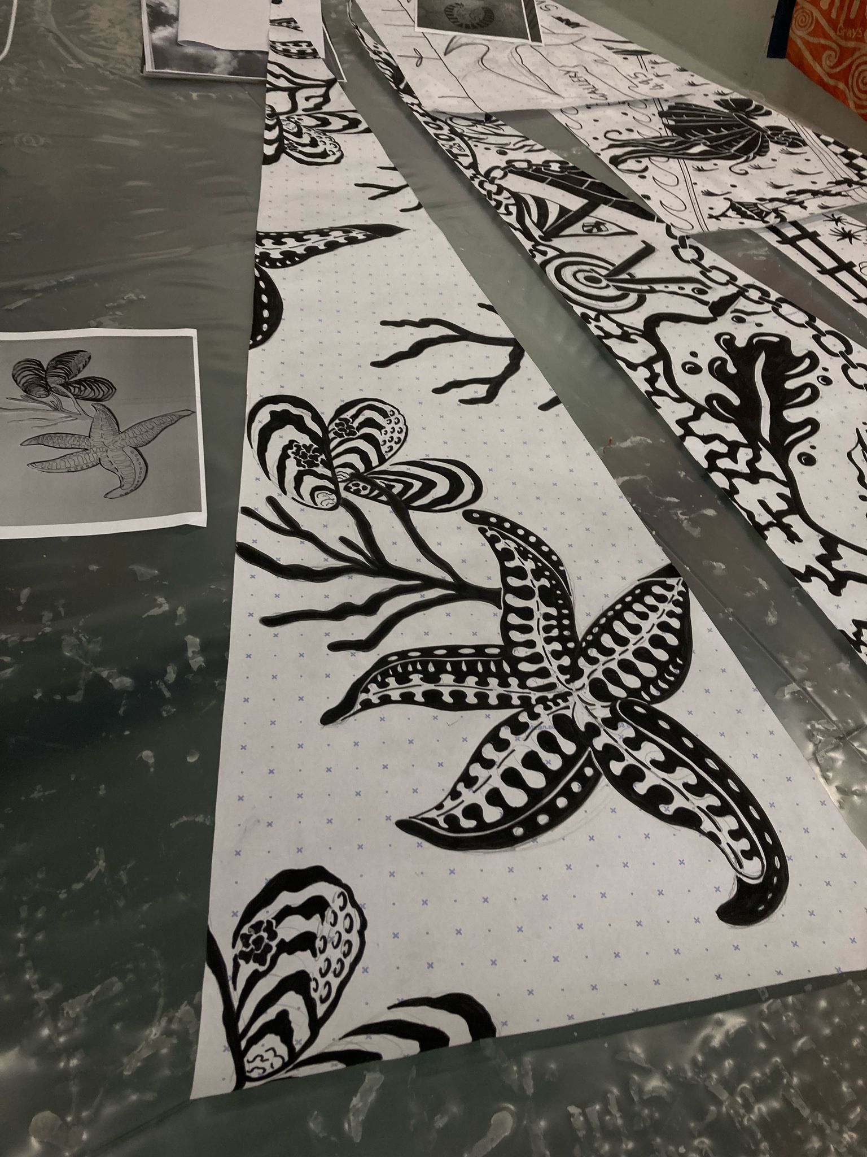
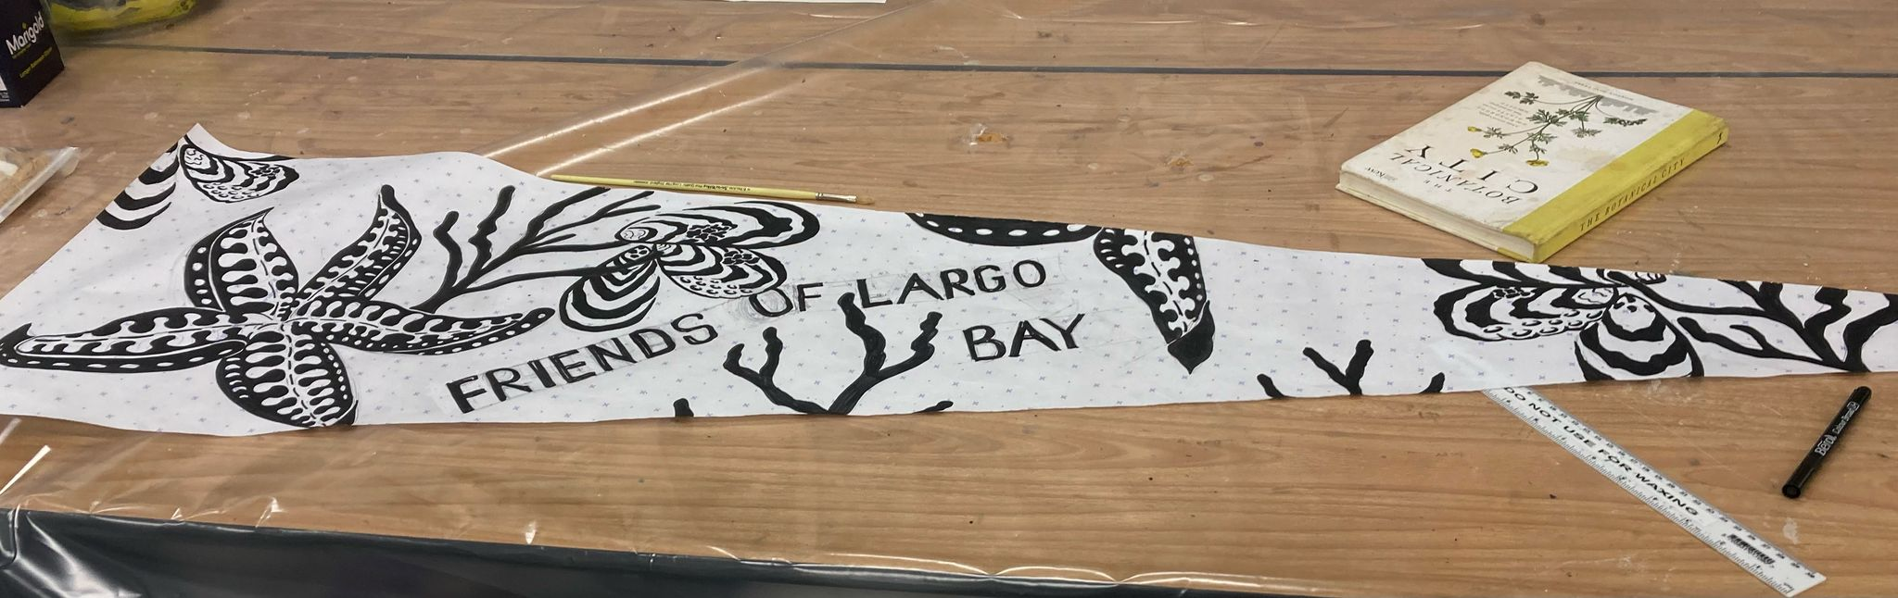
Our Beach of Dreams

Slide 8
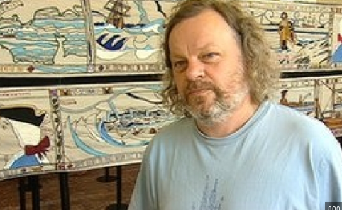
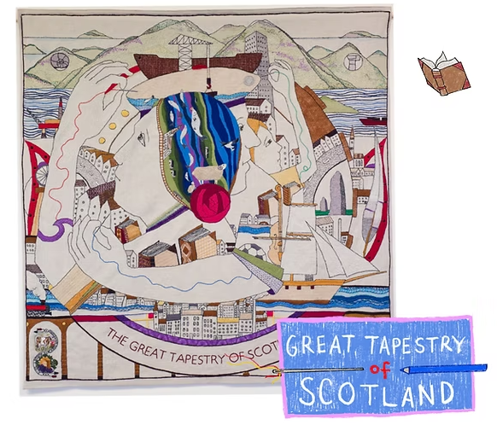
Andrew Crummy - Artist

Slide 9
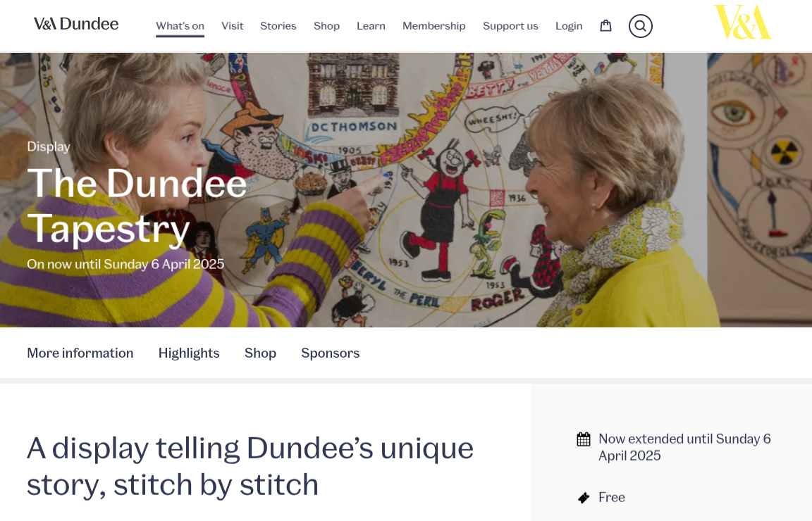
The Dundee Tapestry

Slide 10
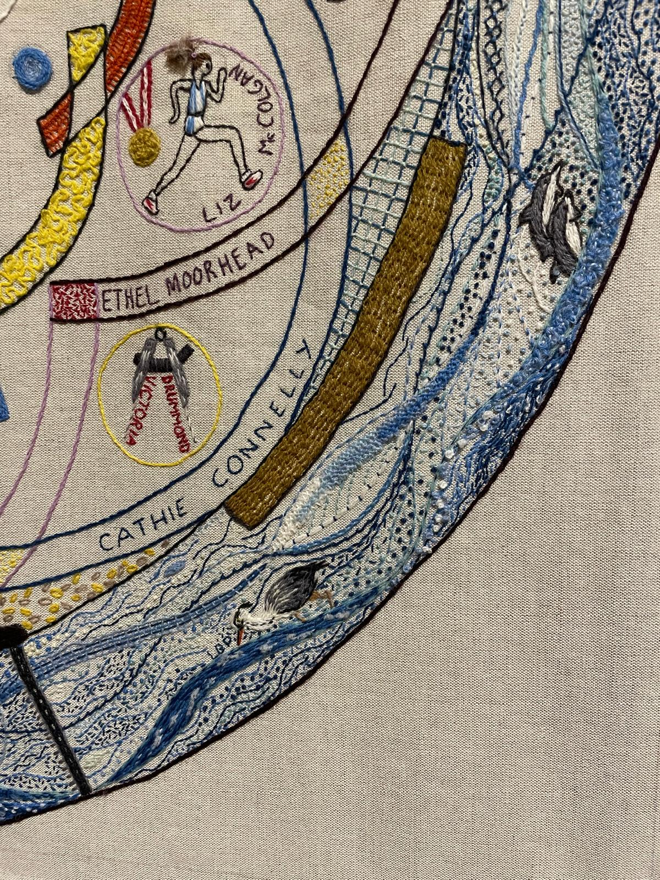
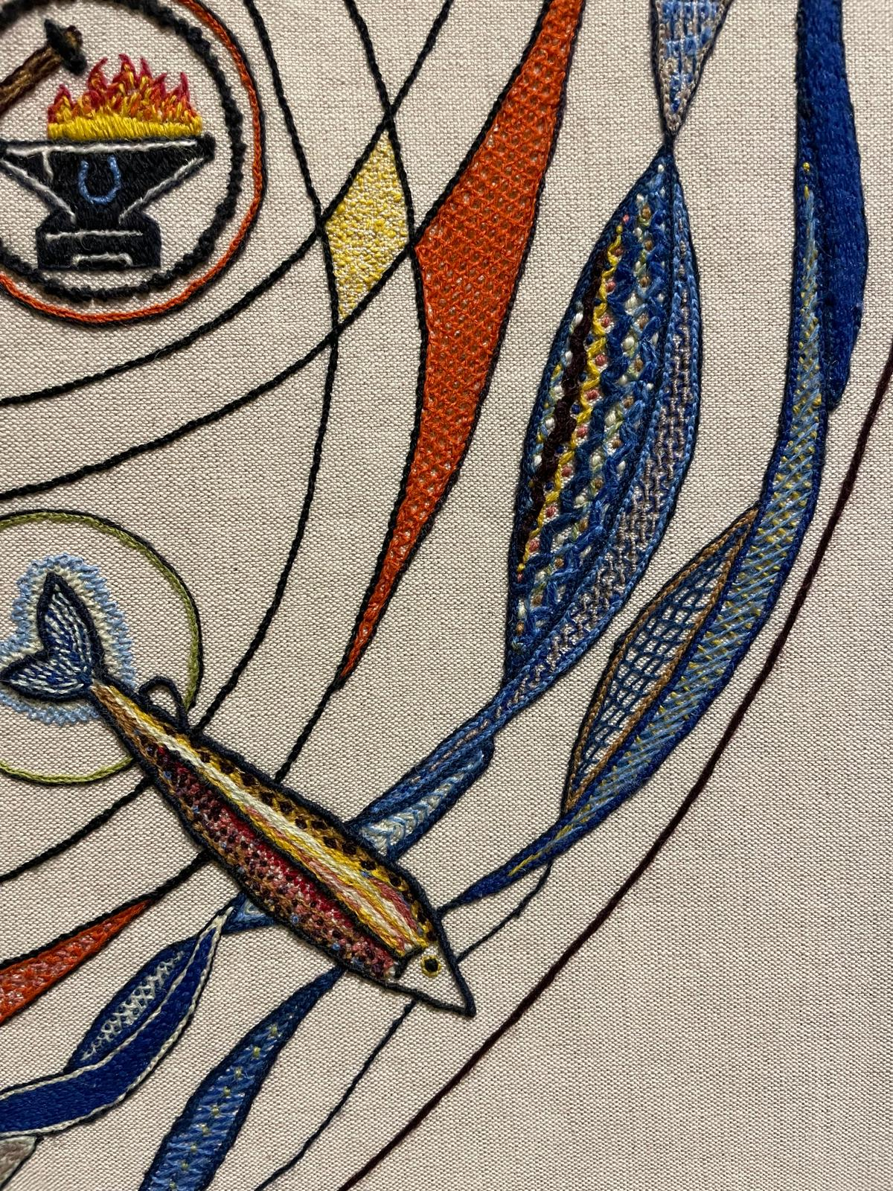
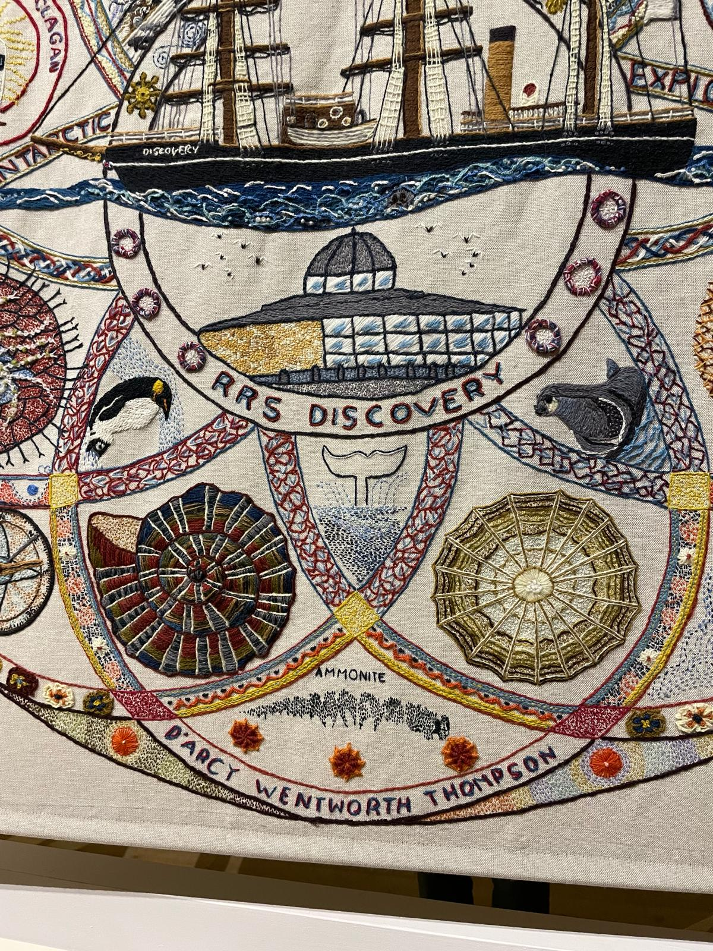

Slide 11
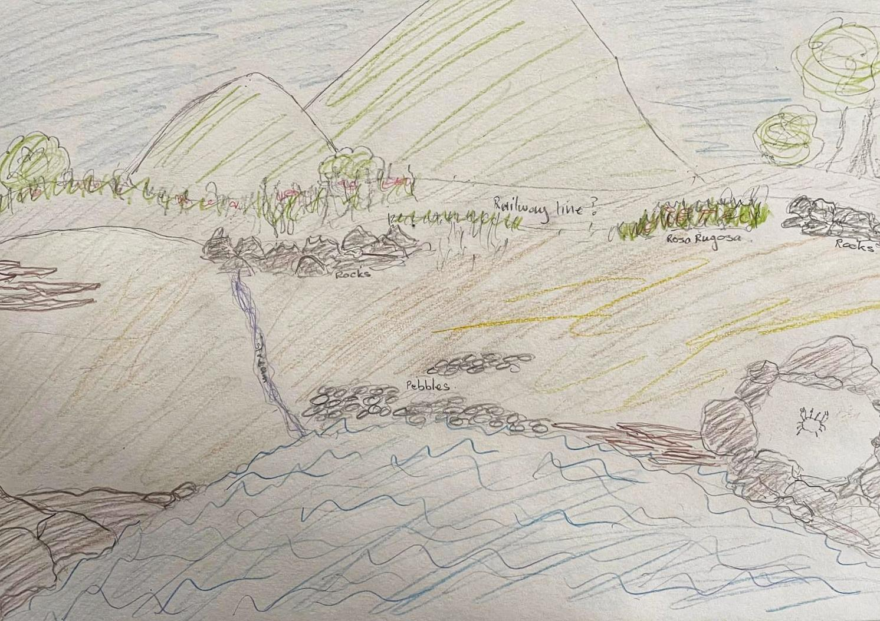
Our Vision: An Impression

Slide 12
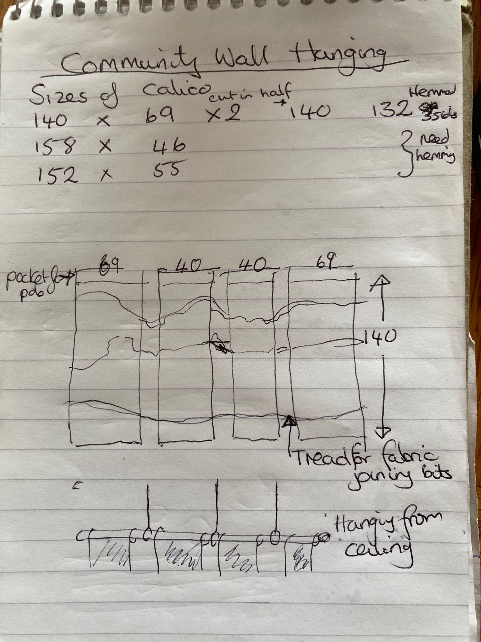
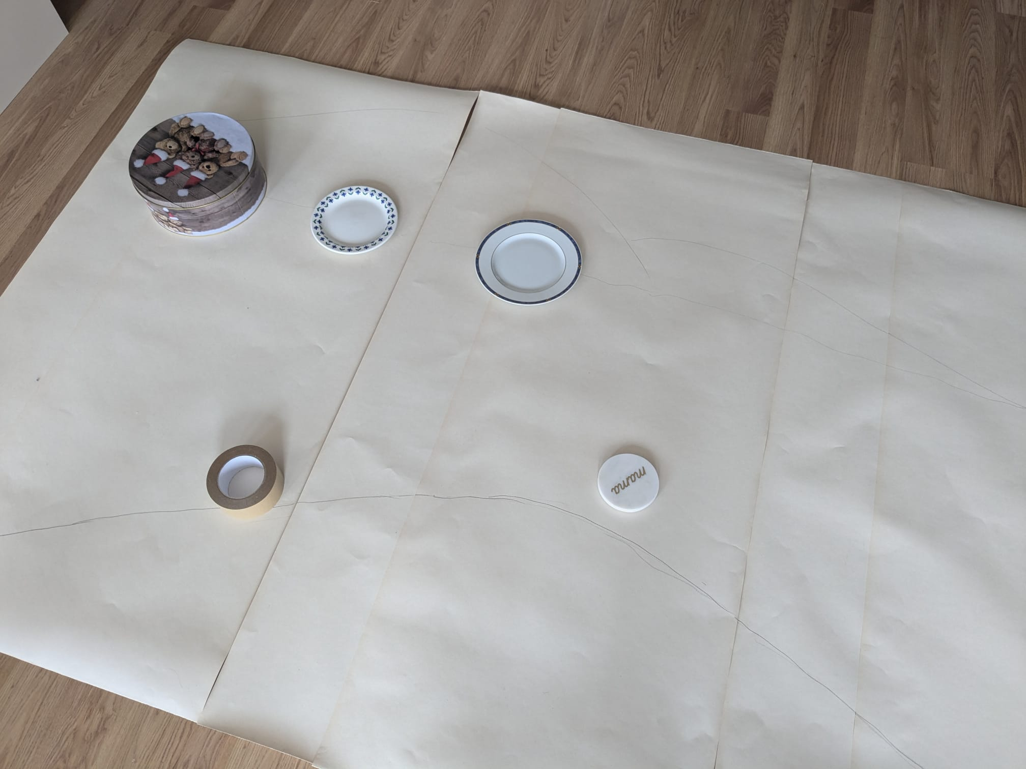

Slide 13
Compositional Elements
Content applied through a process of layering
Backdrop, dyed using natural dyes
Movement, flow - stitches
3 zones - sea, intertidal, shoreline
Species
3 sizes of tiles - circular

Slide 14
Where we are so far…
Design - 3 panels
Community Involvement - groups, families, individuals
2 groups Paxton Centre
Lower Largo Friendship Group
Nursery and Pre-school
Yarnbombers
Skillshare and acquisition - dyeing, needlework, embroidery
Materials - Largo Linen - Donations - Paxton Centre
Material Packs
Location of workshops/drop-ins - Paxton Centre
Timeline - flexible

Slide 15
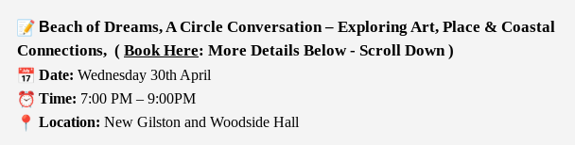

Beach of Dreams: Conversation

Slide 16
Useful Links
https://kinetika.co.uk/portfolio/beach-of-dreams-new
https://www.andrewcrummy.com/
https://www.vam.ac.uk/dundee
https://www.largoct.org.uk/

