Slide 1

ANNUAL GENERAL MEETING OF
LARGO COMMUNITIES TOGETHER
MONDAY 25 November 2024

Slide 2
Agenda
Welcome to the AGM of Largo Communities Together (LCT)
25 November 2024, 7-8pm
@ The Aurrie
Followed by Beach of Dreams
8 pm – 9 pm
1. Welcome everyone!
2. Adoption of Minutes of the 2023 (27 Nov 23) AGM
3. Report from the Chair (Community Action Plan Update).
4. Treasurer's Report and Adoption of Draft Accounts
5. Election of Trustees
8. Beach of Dreams Project for 2025 (8pm – 9pm)
7. Close of formal AGM
Assets/Access Greenways Project 2025

Slide 3
Chair Report
To build a thriving community
by
Listening to our community, creating the right conditions, and supporting sustainable development.
We are:
Representative body
Scottish Charitable Incorporated Organisation regulated by OSCR
Projects with high social impact and/or sustainable development potential
Enhancement of the fabric of our community through the development of our people and groups
Apart from our Development Officer, we are all volunteers!

Slide 4
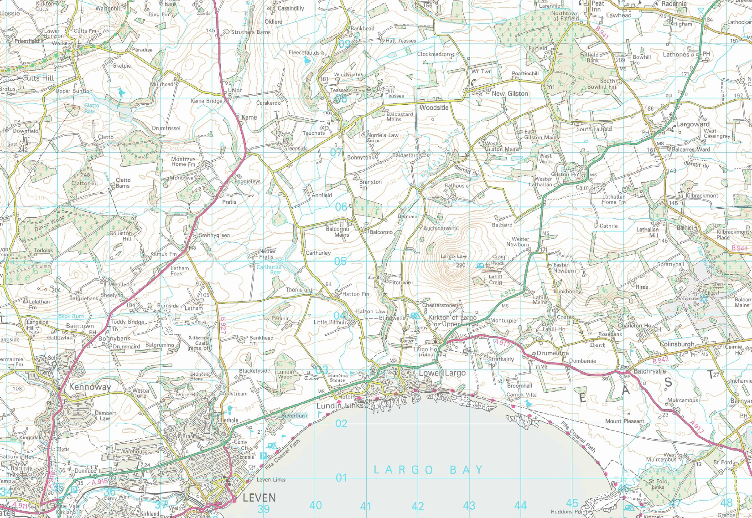




Largo
Communities
Together -
Community
Boundary
3

Slide 5
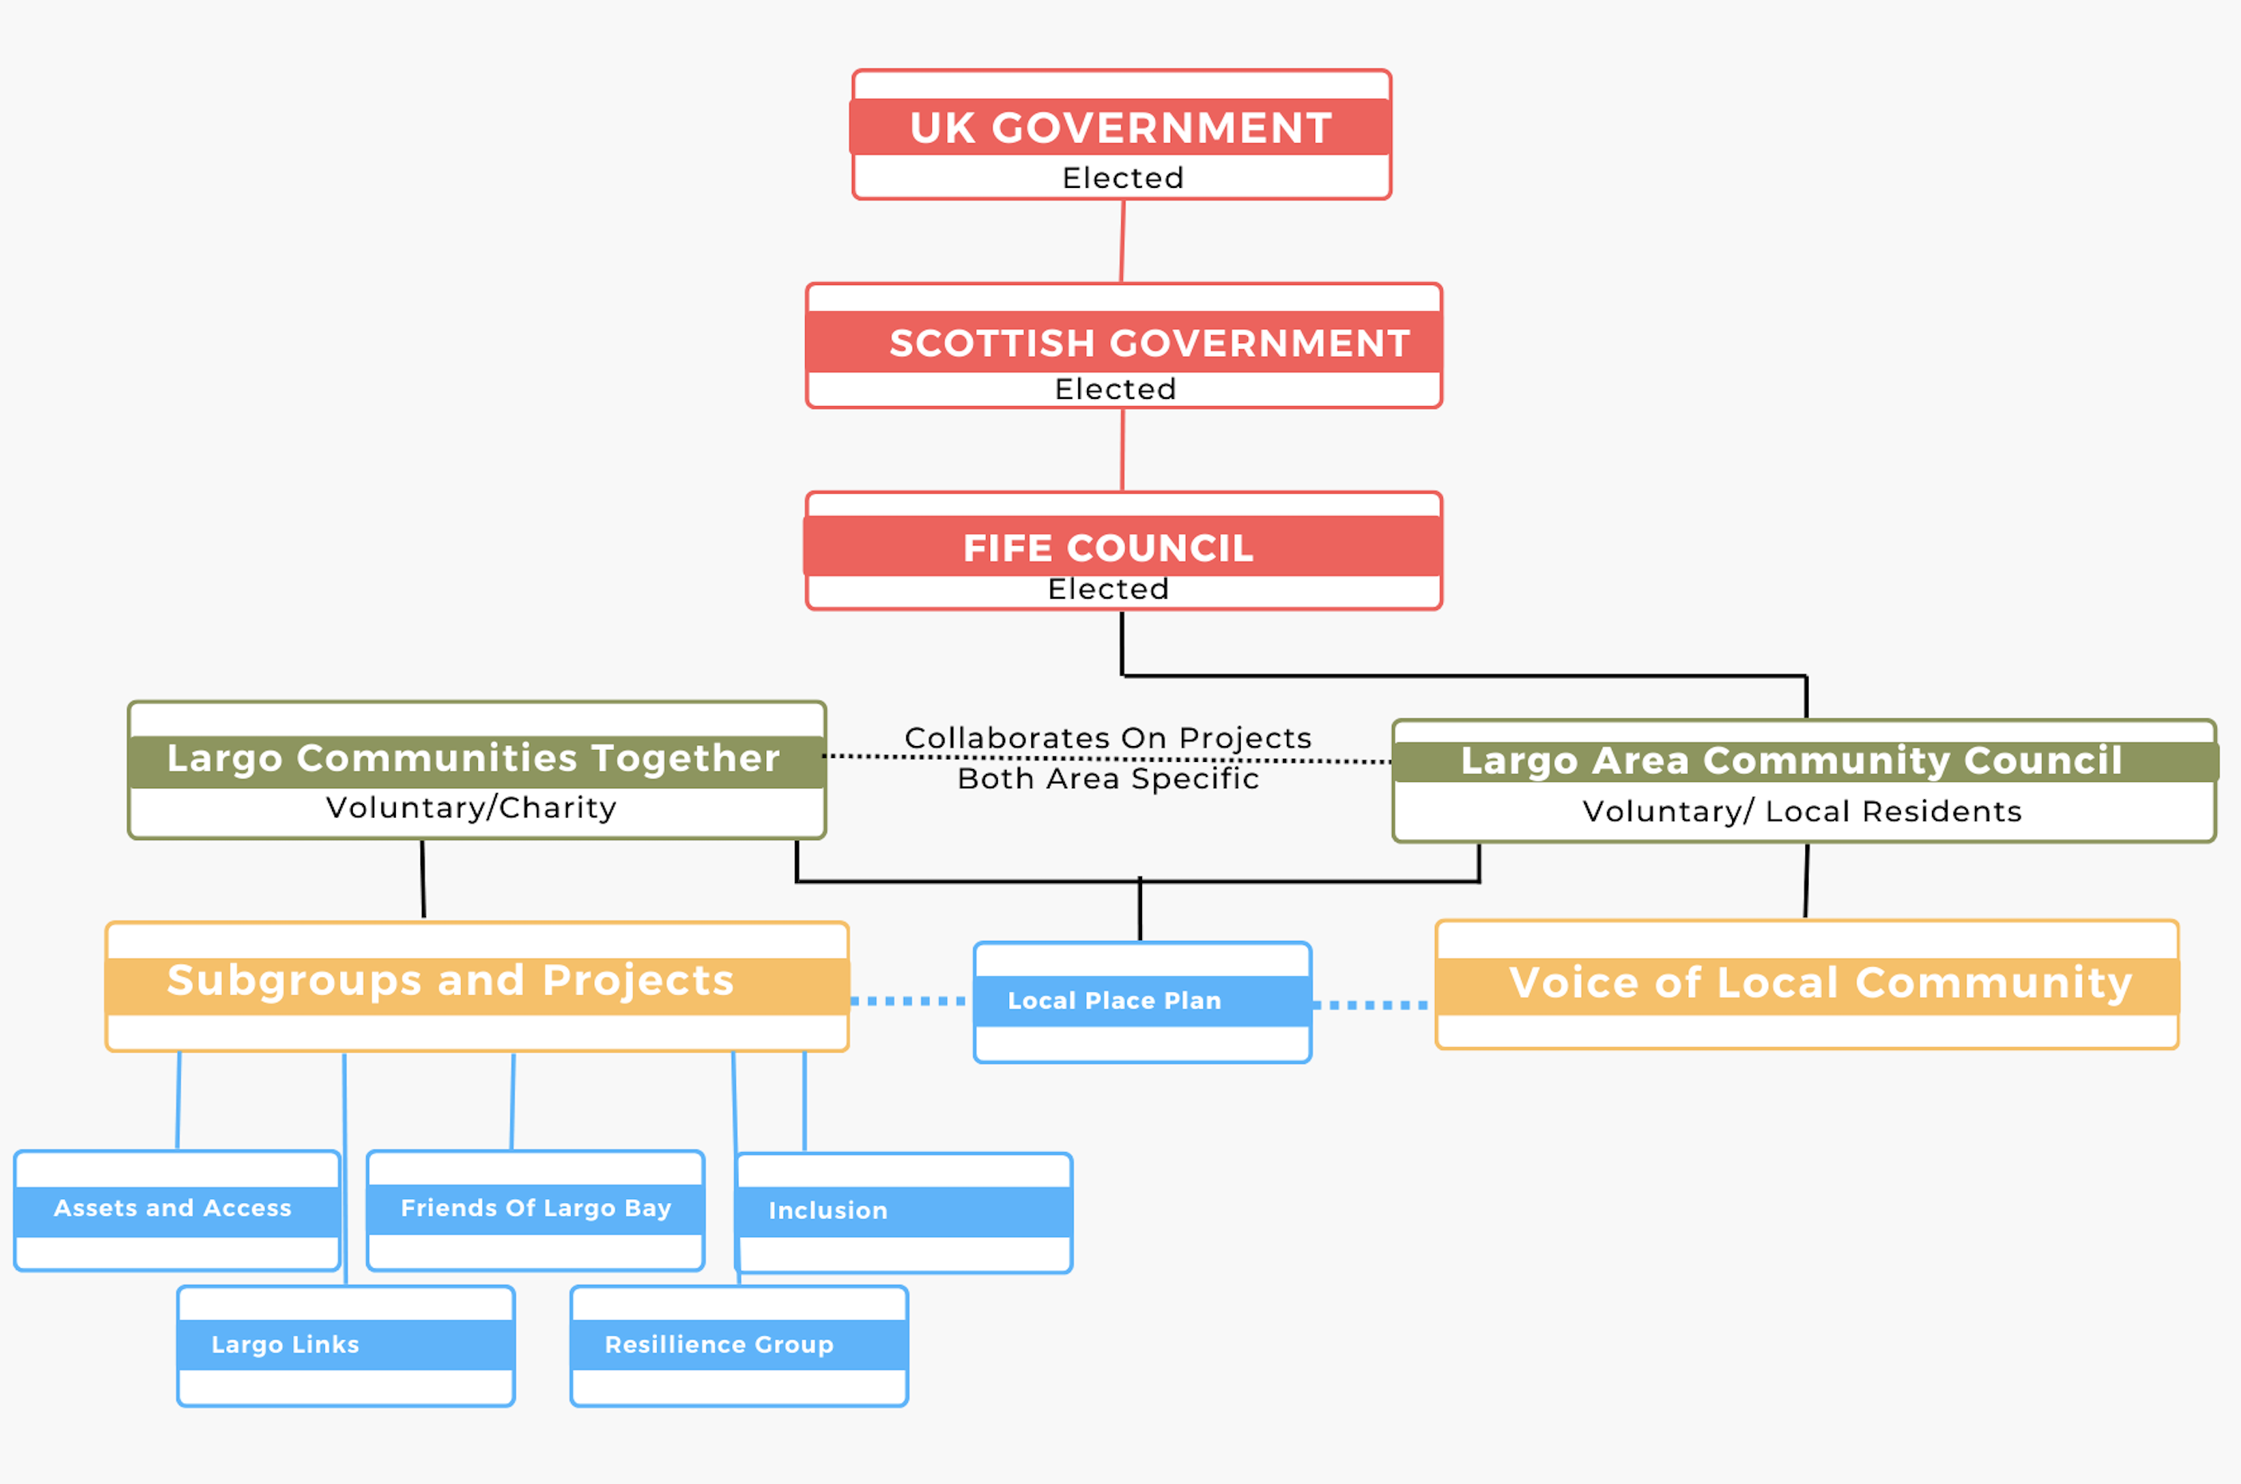
What is the difference between the Largo Area Community Council and LCT?

Slide 6
What is a development trust approach? Sometimes described as community anchor organisations
Autonomy, with governance and direction coming from within the community
A dedication to forming and sustaining community-led partnership initiatives
Listening to our community, creating the right conditions, and supporting sustainable development.
An entrepreneurial spirit that drives innovation and sustainability
A commitment to regenerate the area's economic, environmental and social fabric.

Slide 7

LCT Structure – SCIO 2024
Largo Communities Together (SCIO)
Chair – Louise Robb
Vice Chair - Stan Green
CULTURE & HERITAGE (from Action Plan)
LARGO PIER
RESILIENCE
ASSETS & ACCESS
FRIENDS OF LARGO BAY
Website - Alan Tomkins
IT – Andrew Graham
Treasurer – Stuart Kerr
+ P/T Bookkeeper – Claire Wood
Lynch Bookkeeping
Marketing and Communications – Alistair Brown; Largo Links Editor – Greg Smith
Governance and Compliance – Emily Macdonald
Equity and Inclusion – Jan Kerr
Changing Places Toilet
Minutes Secretary - Nora Conlin
SUSTAINABLE PEOPLE/FINANCE/GOVERNANCE PLAN
LPP/COMMUNITY ACTION PLAN
DEVELOPMENT OFFICER / Priya Logan
Community Sustainable Development - Jill Miller
Youth Representative – TBA
Links with School via FoLB
Youth Liaison built into all projects
Culture & Heritage
Gail Green, Matt Pontin
Levenmouth Area
Pier Renovation
Chair: Brendan Diamond/Raymond Muszynski. (Jimmy Simpson retired.)
Team of 8
Community Resilience
Chair: JP & Liz Easton
Team: Jan, Nora, Peter, Stuart. Volunteers bank.
Assets and Access
Chair: Andy Duff
Team of 6
Friends of Largo Bay
Chair: Carol Duff
Team of 8
381 Facebook followers!

Slide 8
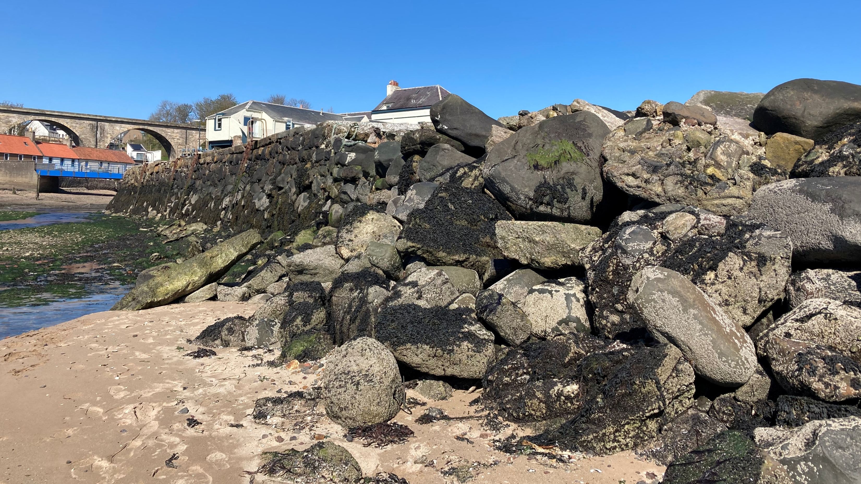
Largo Pier
Largo Pier: A Community Conversation 29 October 2024
at the Durham Hall attended by 60 community members
Notes:
IMAGE. A beautiful photo of Largo Pier in its current state

Slide 9
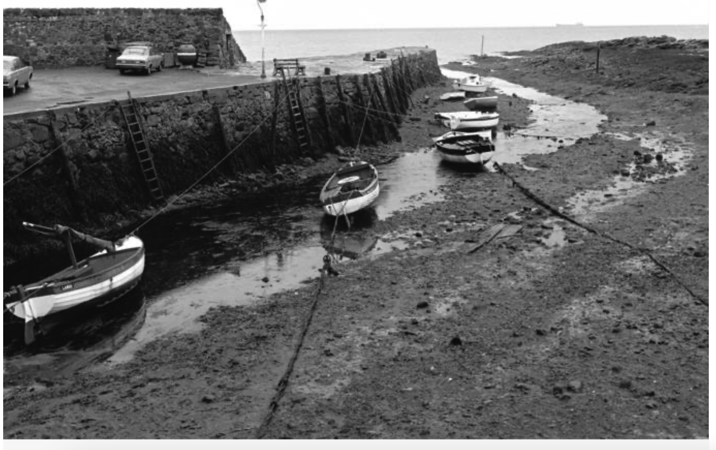
Purpose of the Meeting / Agenda
To say thanks
To share the story
Funds raised, funds spent, reasons for the crossroads.
To share the challenges of the funding climate
Notes:
Purpose of the Evening:
To express gratitude for the support received throughout the 6-year journey of the Largo Pier project.
To share the story of the project's funding efforts, including funds raised, how they were spent, and the reasons for pausing the current phase.
To discuss the challenging grant funding climate and its impact on the project.
Introductions:
Introduce the members of the Largo Pier Committee.
Facilitate introductions among attendees at each table.
Agenda:
Briefly outline the agenda for the evening's discussions and presentations.
Parking Lot:
Introduce the concept of a "parking lot" to record any questions that cannot be immediately addressed during the session.
Chair Role:
Clarify the role of the chair in facilitating discussions and ensuring a productive session.

Slide 10
Key achievements in our 6th year of operations – 2024
Trustees - Quarterly strategic meetings, research, and learning from other Trusts in Scotland, are moving LCT to a sustainable footing. All the work to keep the structure of LCT legal and funded.
The Local Place Plan was submitted to and accepted by Fife Council in June 2024. The Community Action Plan was collated from your 100+ inputs.
Community Resilience Team – Dementia-friendly community training workshops, successful Big Picnic, strengthening community resilience framework, co-ordination of Warm Spaces for community to meet and eat.
Largo Links Magazine - four issues distributed this year to every home.
Largo Pier reached a crossroads when it could not secure major funding. Community meeting held 29 Oct 2024. Six years of tireless work by Chair Jimmy Simpson and his team of engineers, experts and fundraisers.
Assets and Access – investigations on land ownership, the potential for affordable housing, identifying and securing important community assets, and accessible pathways within our community.
Marketing and Comms – regular newsletters via email and Facebook on all things within the Largo Area, written and distributed by our Development Officer, Priya.
Equity and Inclusion - Changing Places Toilet and beach wheelchair projects up and running.
Friends of Largo Bay – focus on art and education, biodiversity monitoring and environmental action - activities well supported by local residents, including regular beach cleans and beach litter surveys.
A detailed report will be available on our website soon and in the Largo Links in the spring

Slide 11
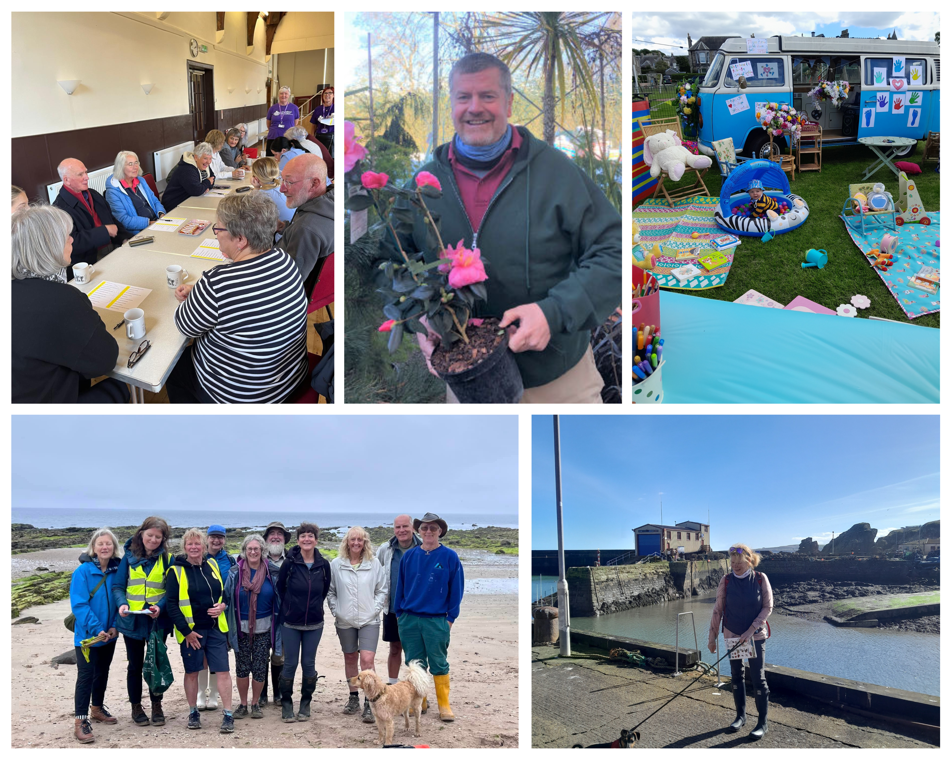
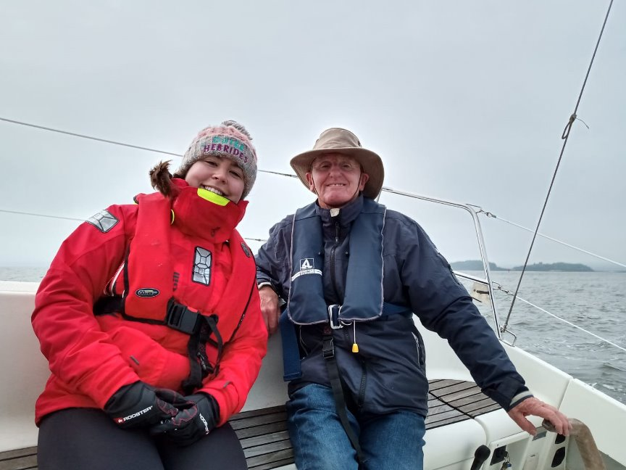
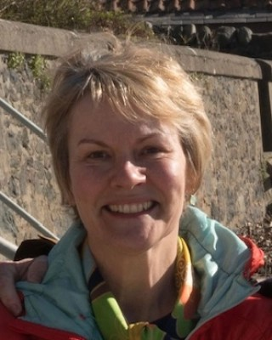
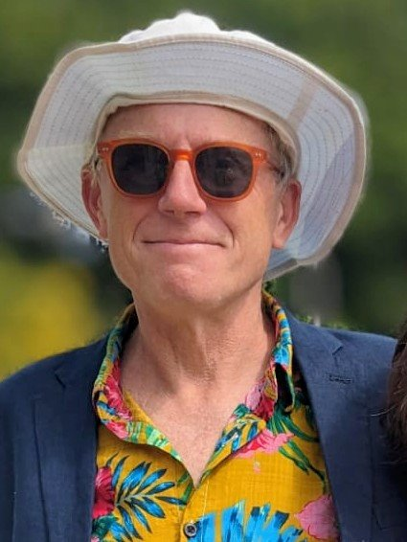
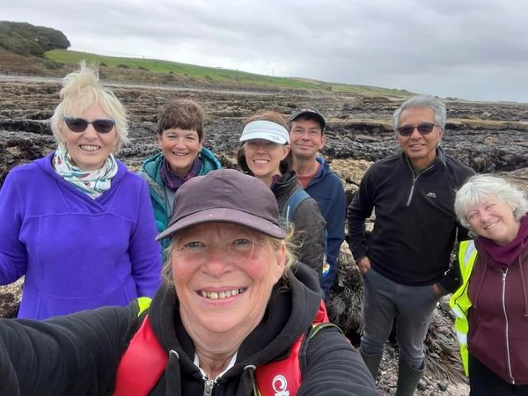
Our People in Pictures

Slide 12
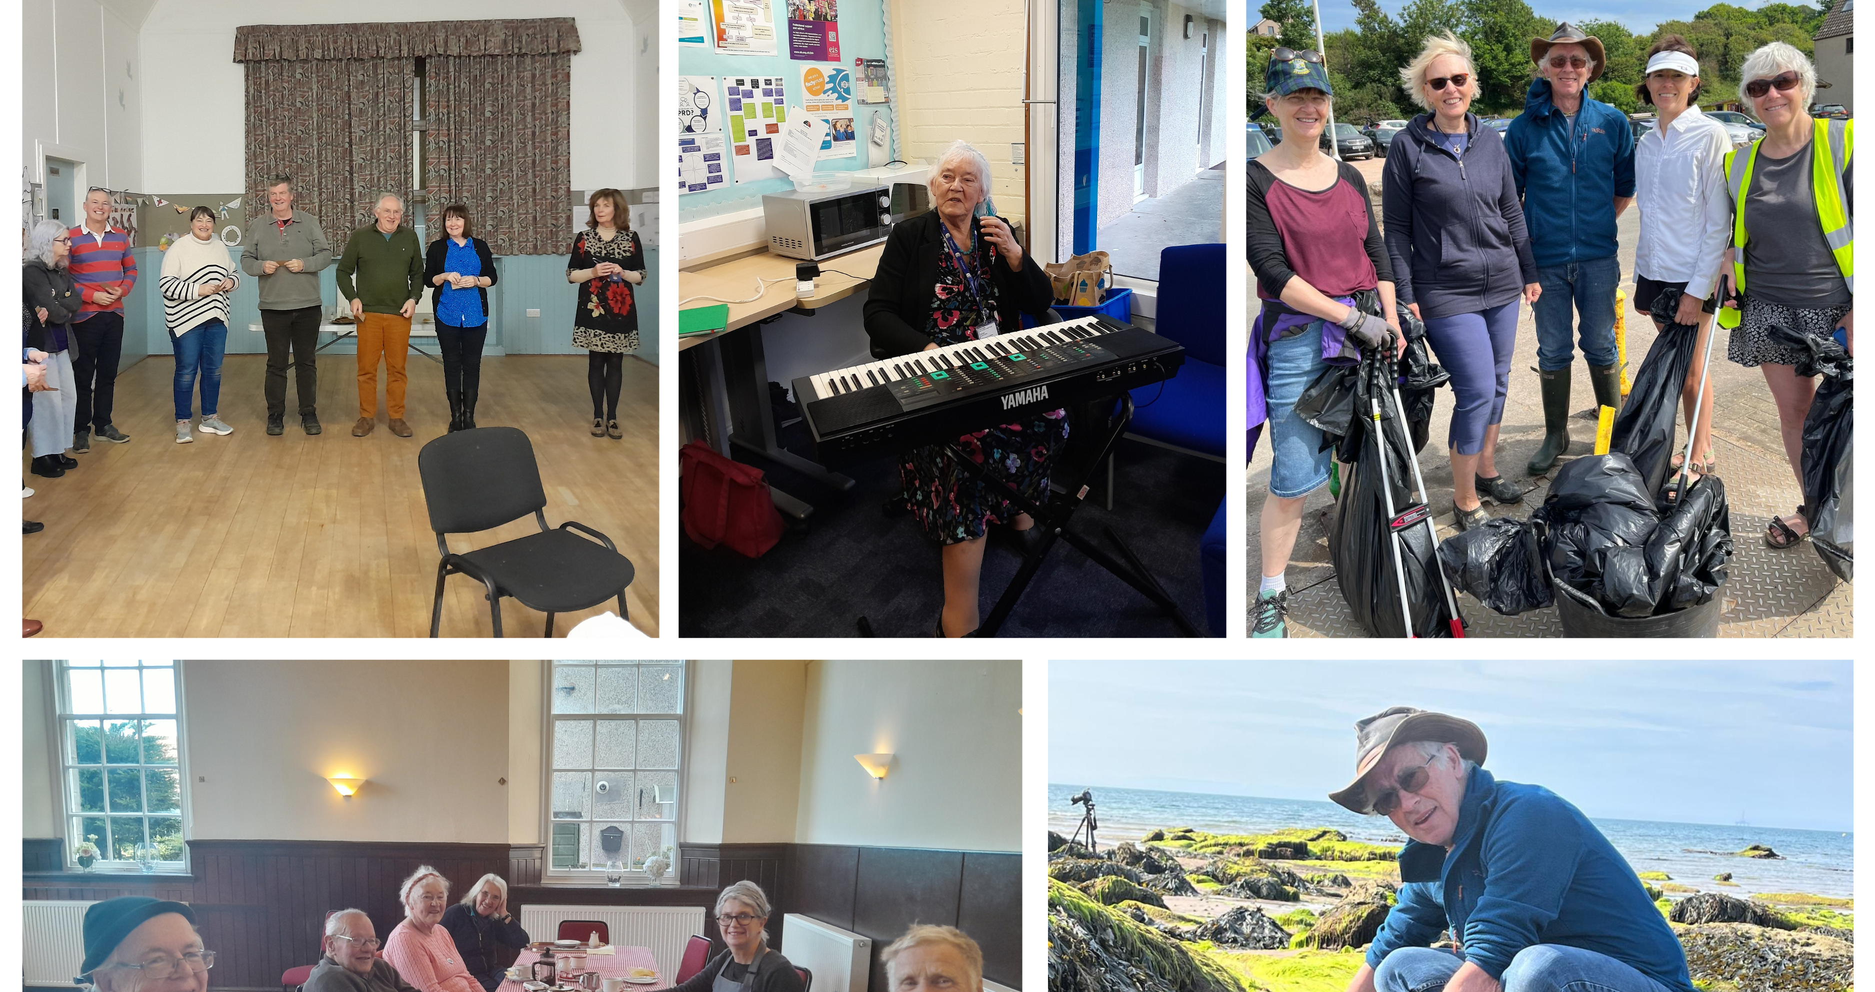
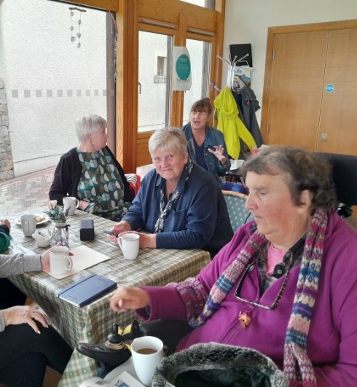
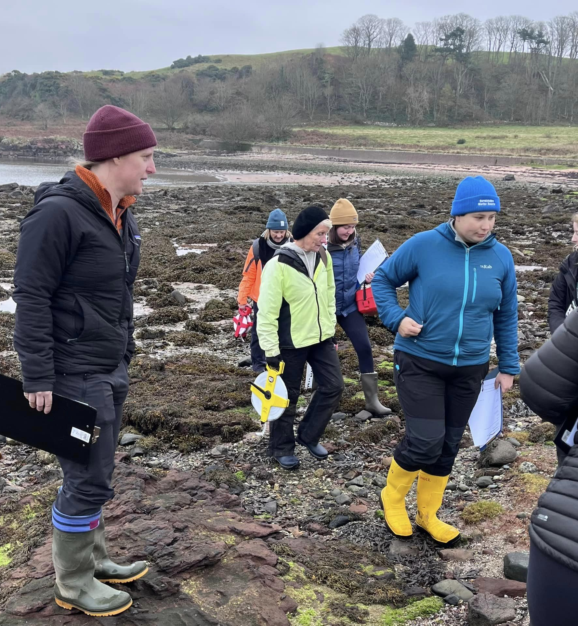
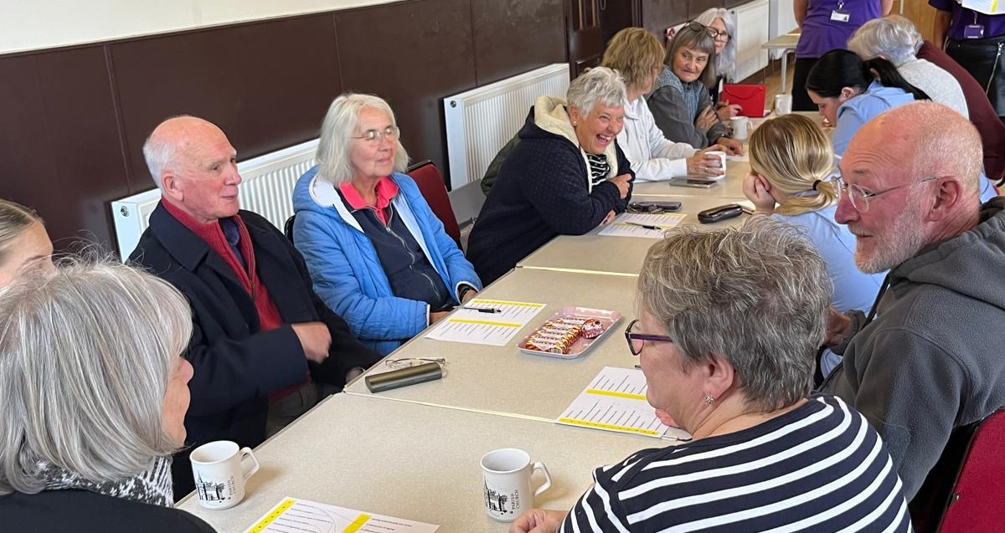
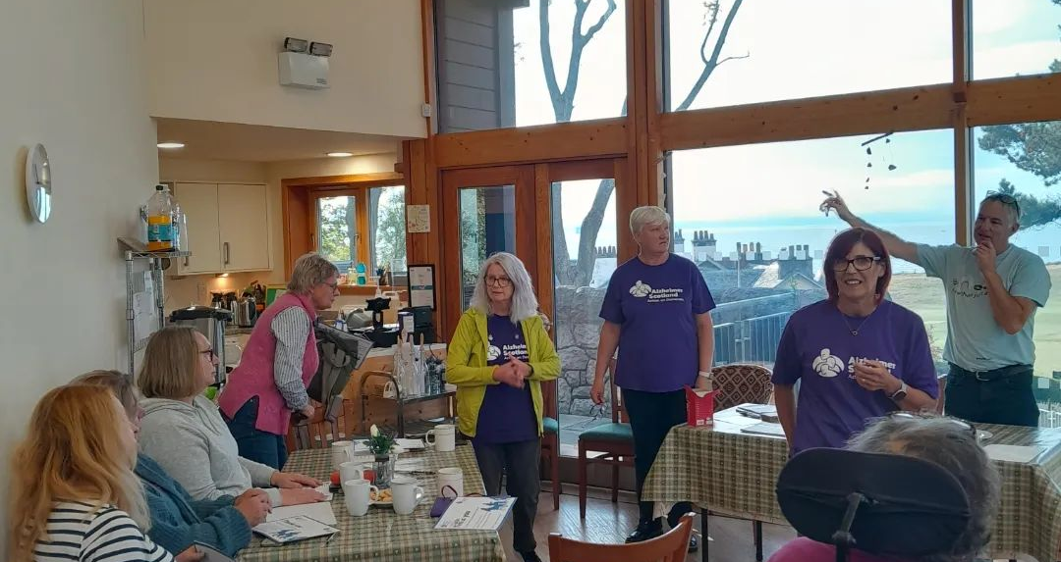
Our People In Pictures
Our people in pictures

Slide 13
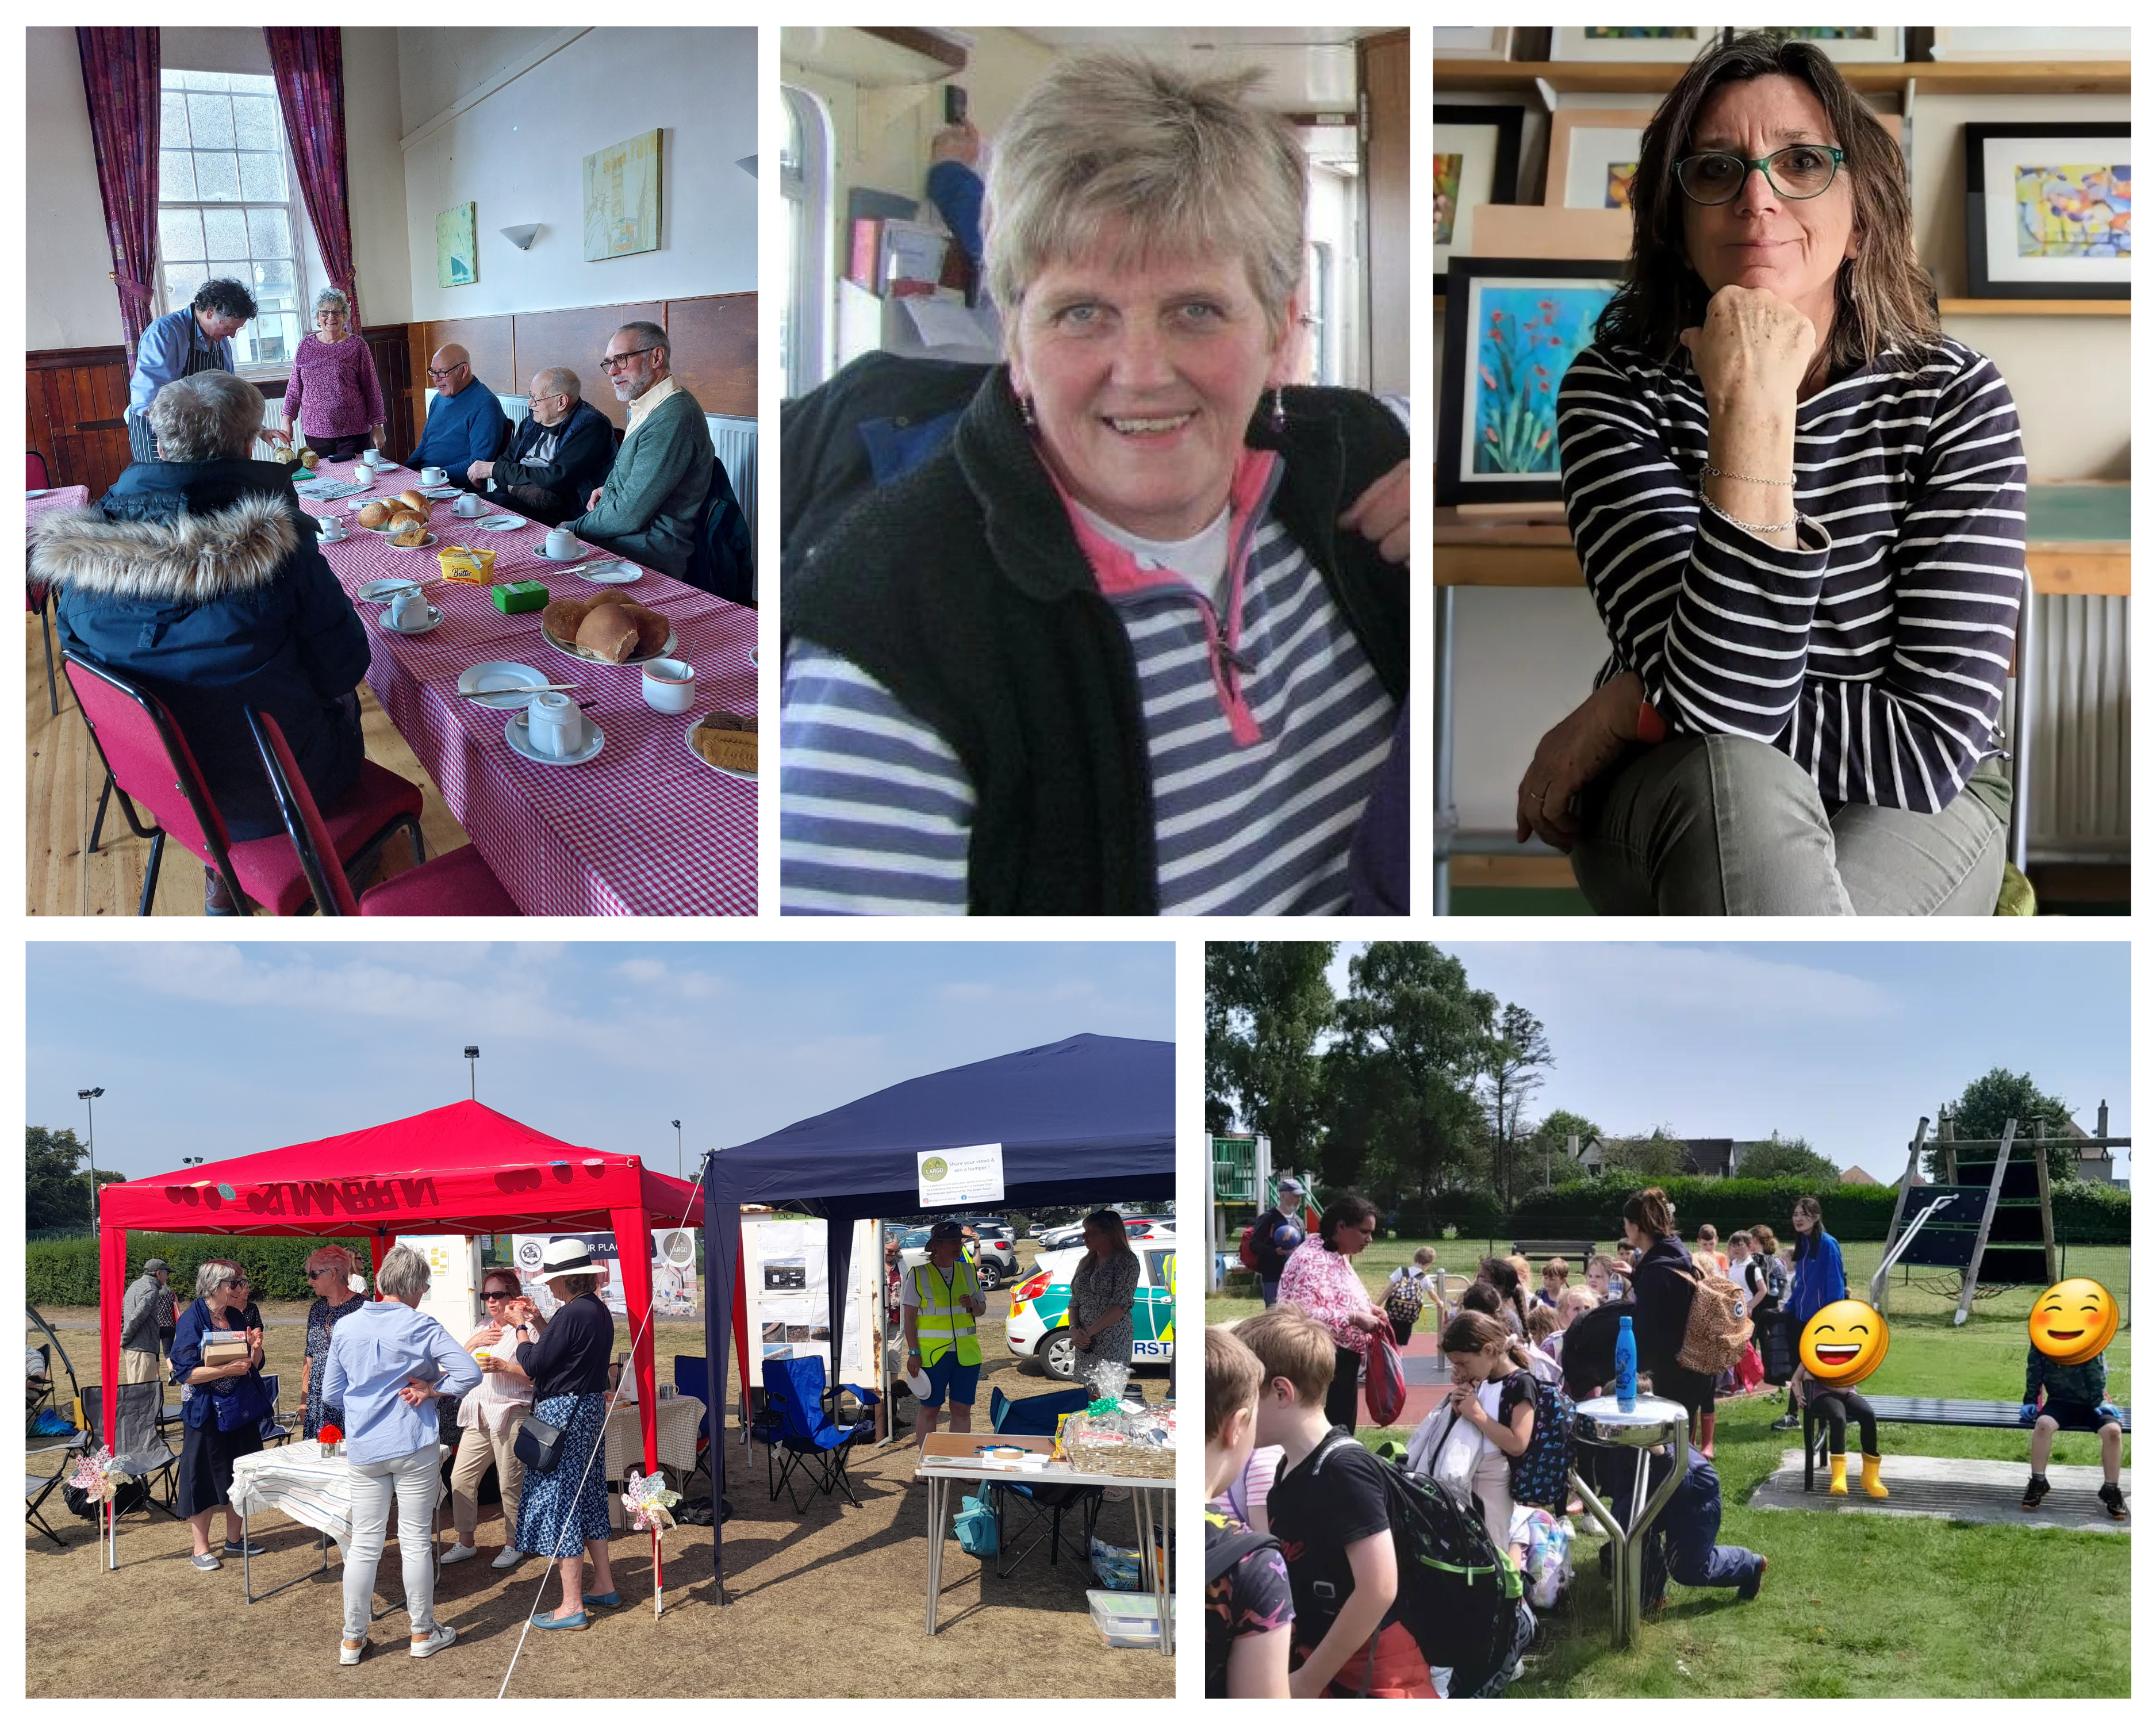
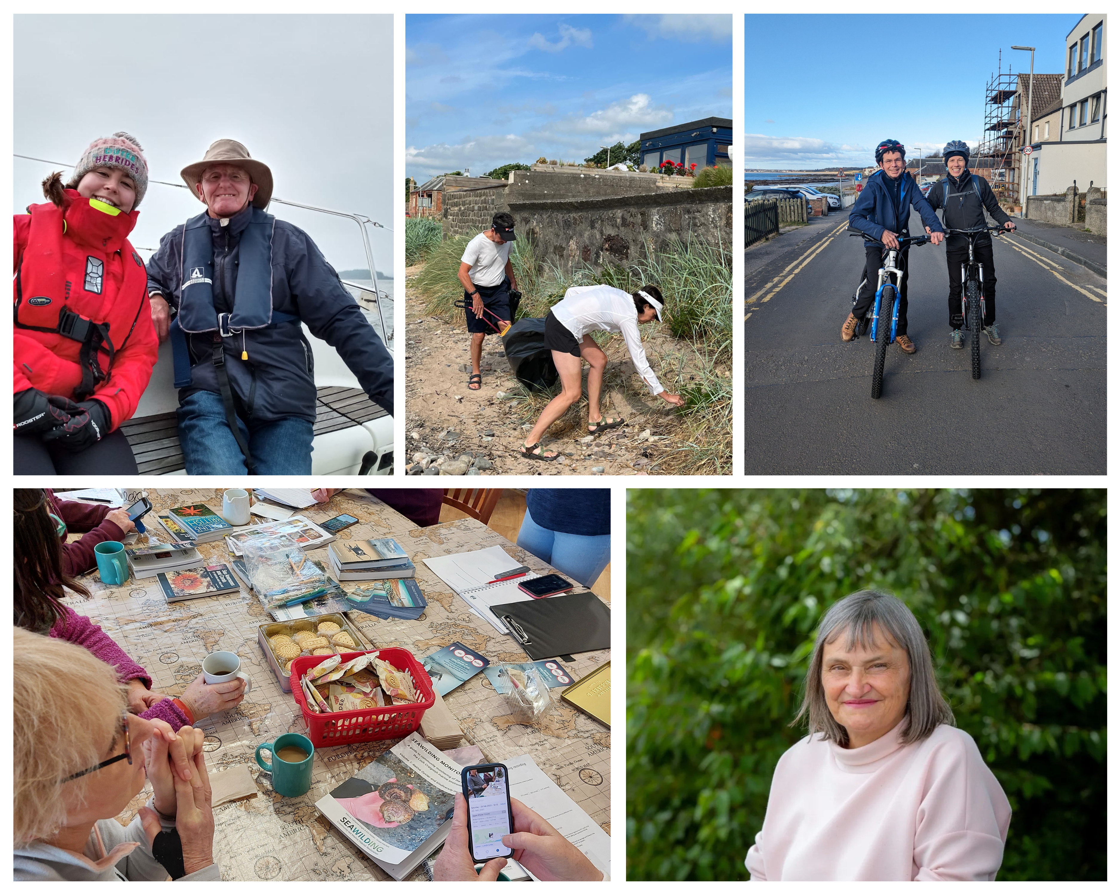
Our People in Pictures

Slide 14
Assets and Access Group 2025
Looking at the 'Action plan' our 4 items of focus were ...
1. Lundin Links Hotel Site
A site with huge potential short and long term use by the community
But … complicated by receivership legalities, and politics
We (well actually Stan!) are persevering
Watch this space for developments
A long-term aspiration for LCT
BUT the legislation for successful community ownership is still a hard and expensive journey
We continue to look-out for opportunities
This is where we intend to spend our energies as a group in 2025
The Largo Area Greenways Project
Community Engagement, Promote, Manage, Extend
Please get involved!
Email me to help arduff@largoct.org.uk
2. Community Led Housing
3. Safe and Sound Spaces
4. Get Active , Get Connected

Slide 15
Treasurer’s report
Draft accounts for the year ended 30 June 2024
Reviewed by independent examiner and Trustees - will be submitted to OSCR once members and trustees approve.
 | 2023-2024 | 2022-2023
Receipts | £69,225 | £52,595
Payments | £57,348 | £52,347
Surplus/(Deficit) | £11,877 | £248
Income: donations, grants, fundraising activities (Largo Links magazine)
Expenditure: mainly on projects and funded by grants
Reserves of £3,949 vs. target of £3,000
Healthy year-end financial position & going concern

Slide 16
Cash and bank balances
Six grants were received during 2023-2024, thank you to all our supporters
DTAS – Supporting Communities Programme – Community Development Officer
Fife Council Local Community Planning Budget – Local Place Plan consultations
Various – Beach Wheelchairs
Crown Estate - Seaweed Workshops/feasibility of seaweed farm - Grant
Fife Health & Social Care Partnership - Community Chest Fund - Lower Largo Friendship Group
Levenmouth Reconnected Programme – Largo Pier – quantity surveyance
 | 2023-2024 |  |  | 2022-2023
 | Unrestricted | Restricted | Total | Total
Cash and bank balances | £3,949 | £46,758 | £50,707 | £38,830

Slide 17
Members adoption of Accounts
Show of hands if you are prepared to adopt the draft accounts as presented, please!
The Trustees will sign off on the accounts once they have been reviewed by accountant, Lynn Cunningham of Cunningham Grant, CA
Thank you!
16

Slide 18
Election of Trustees
Trustee Election Nominees:
Nora Conlin
Brendan Diamond
JP Easton
Emily Macdonald
Louise Robb
Thank you to Jimmy Simpson who was Chair of the Pier Group and LCT Trustee until he retired in August 2024.
Thank you to Stuart Kerr – Treasurer and Trustee
Thank you to James Kay, editor of Largo Links who retired in summer.
Three longest serving trustees to retire – Nora, Emily & Louise
Two trustees appointed by Trustees to retire – JP & Brendan.
Five Trustee nominees for members to elect.
Proxy votes will be added to the votes you cast tonight.
We will do this live on a spreadsheet so you can see the process.
There will be five shows of hands in total.
Please only vote if you are a full member and have not completed a proxy vote.
17

Slide 19

And finally...
Any other business?
Presentation on the Beach of Dreams next
Thank you everyone for attending!

Slide 20
Contact Us
Email: secretary@largoCT.org.uk
Post: Largo Communities Together, 7 Lundin Square, Lundin Links, KY8 6BH
Website: www.largocommunitiestogether.org.uk
Facebook: www.facebook.com/largocommunities

Slide 21
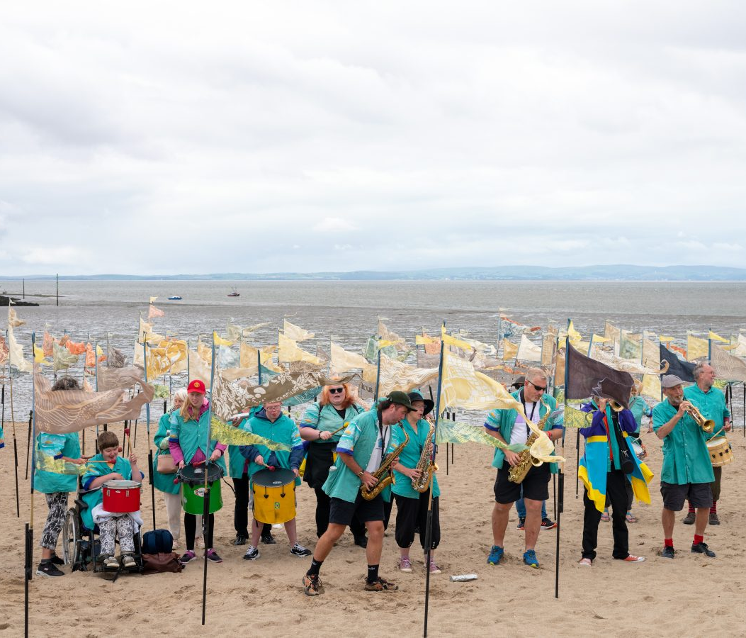
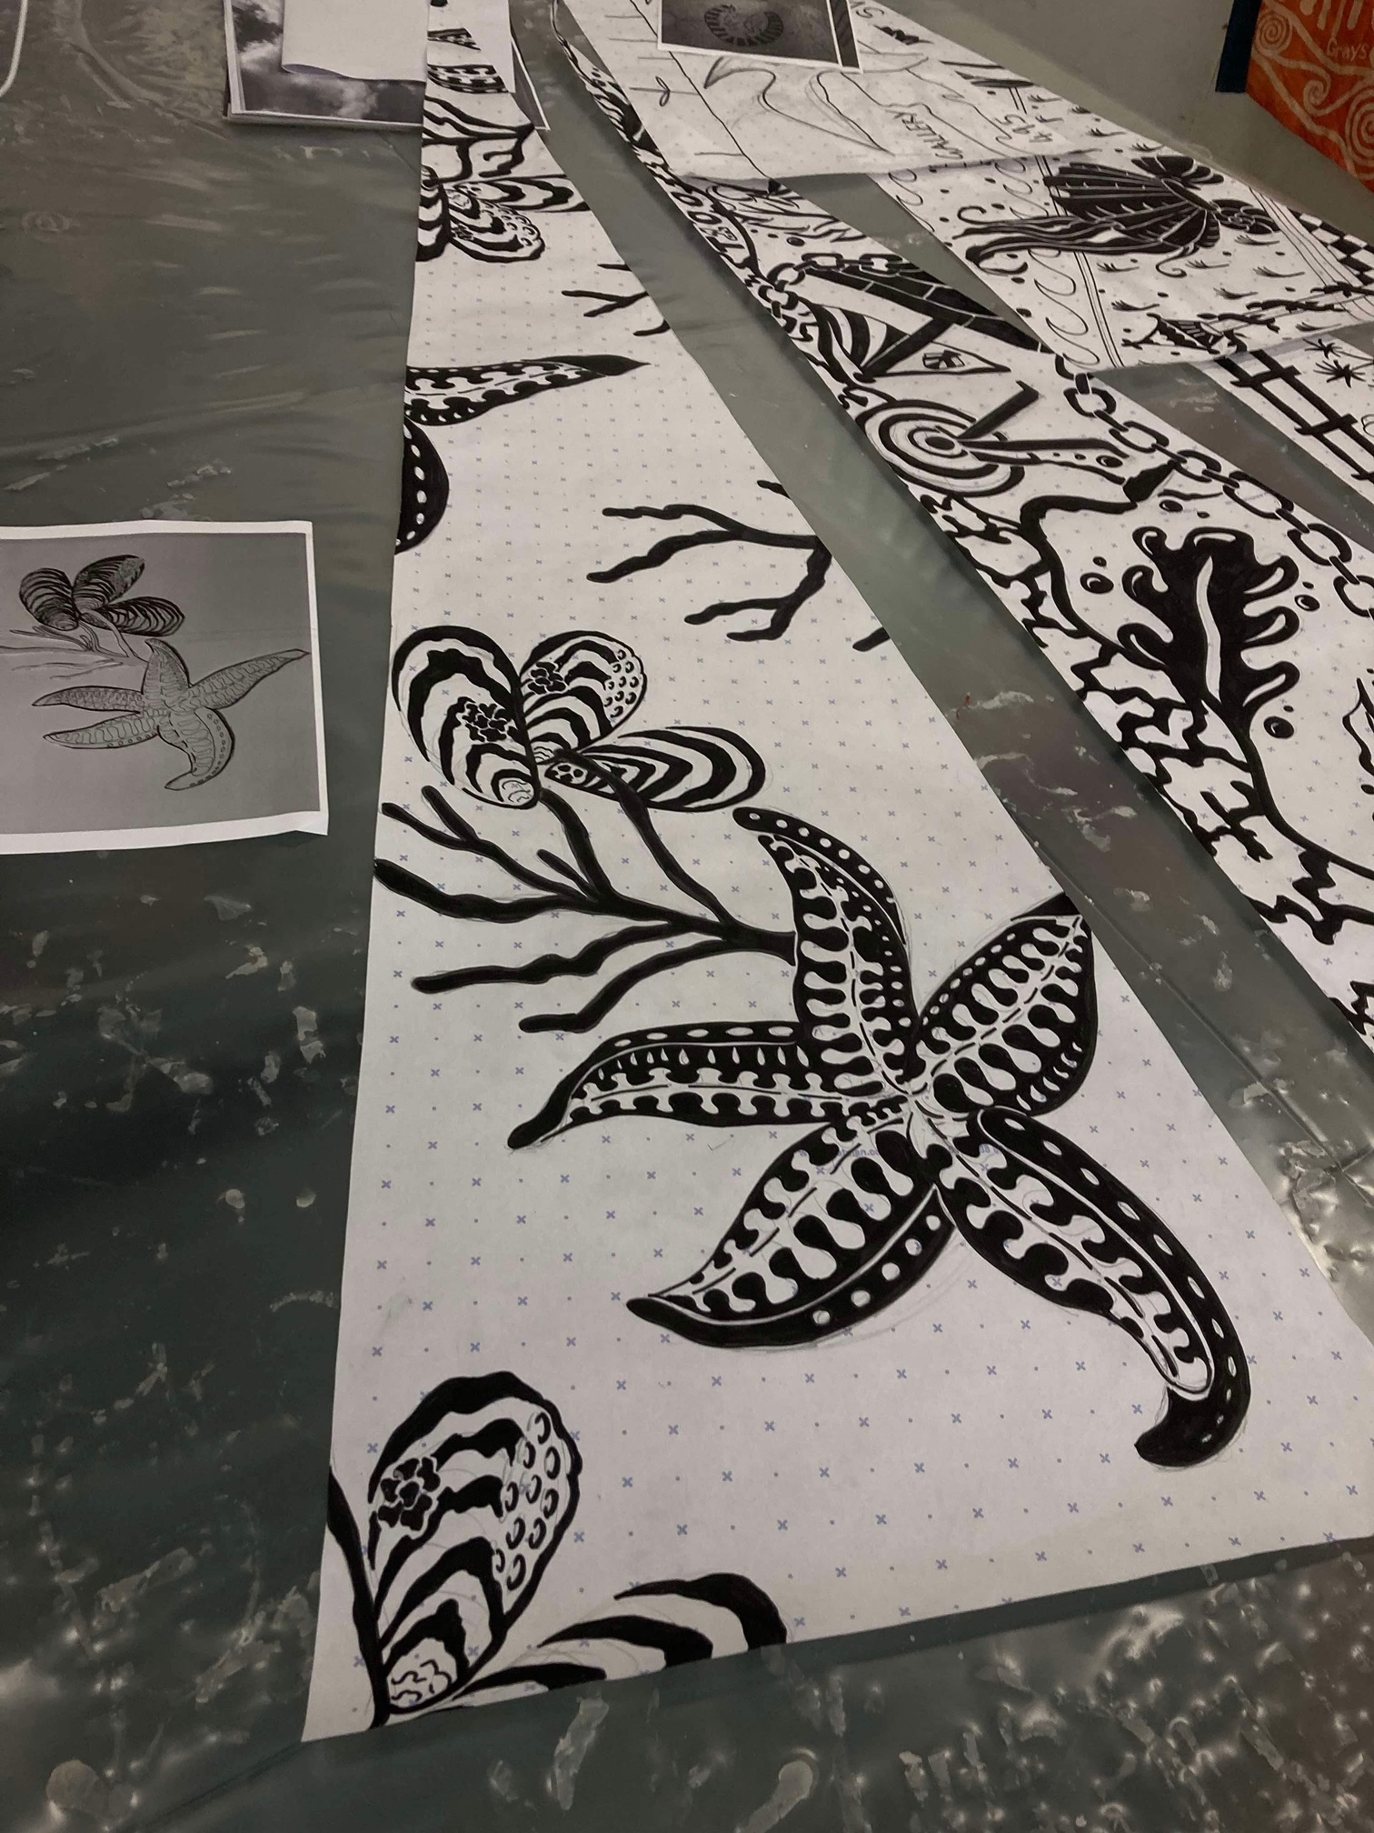
Beach of Dreams FoLB Carol and Sue.
'Beach of Dreams is more than just a festival; it’s a journey through the diverse landscapes and rich histories of our coastal regions. Each step along the shore is a celebration of the natural beauty and cultural heritage that make our coastlines unique.'

Slide 22
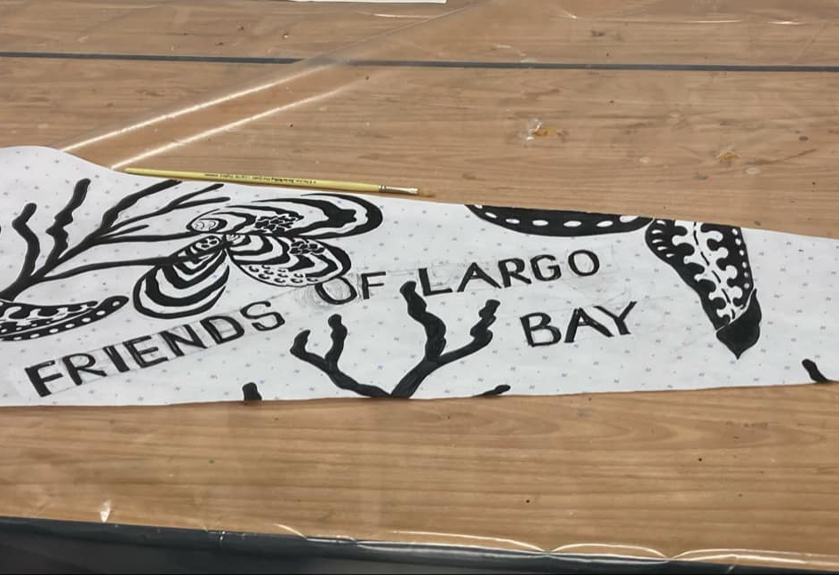
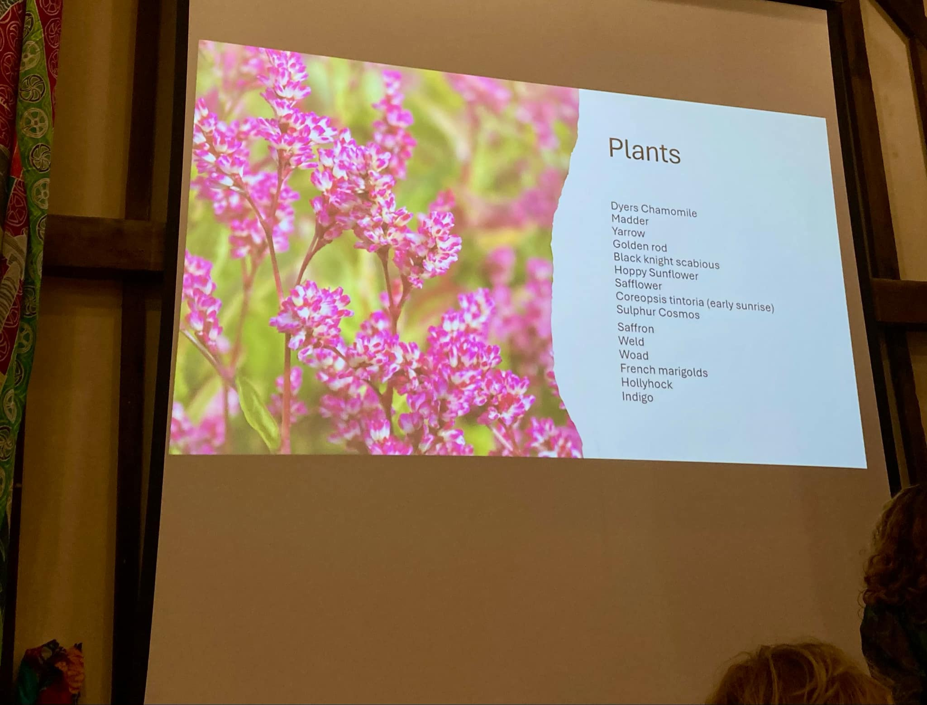
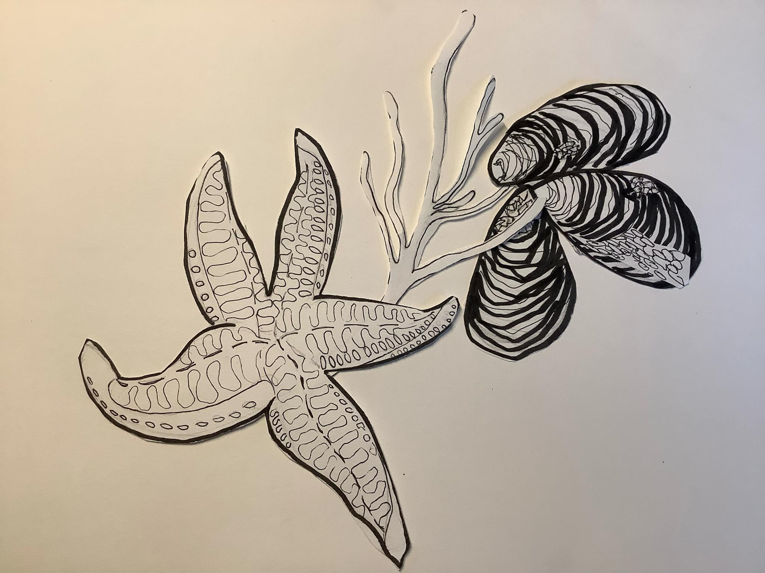
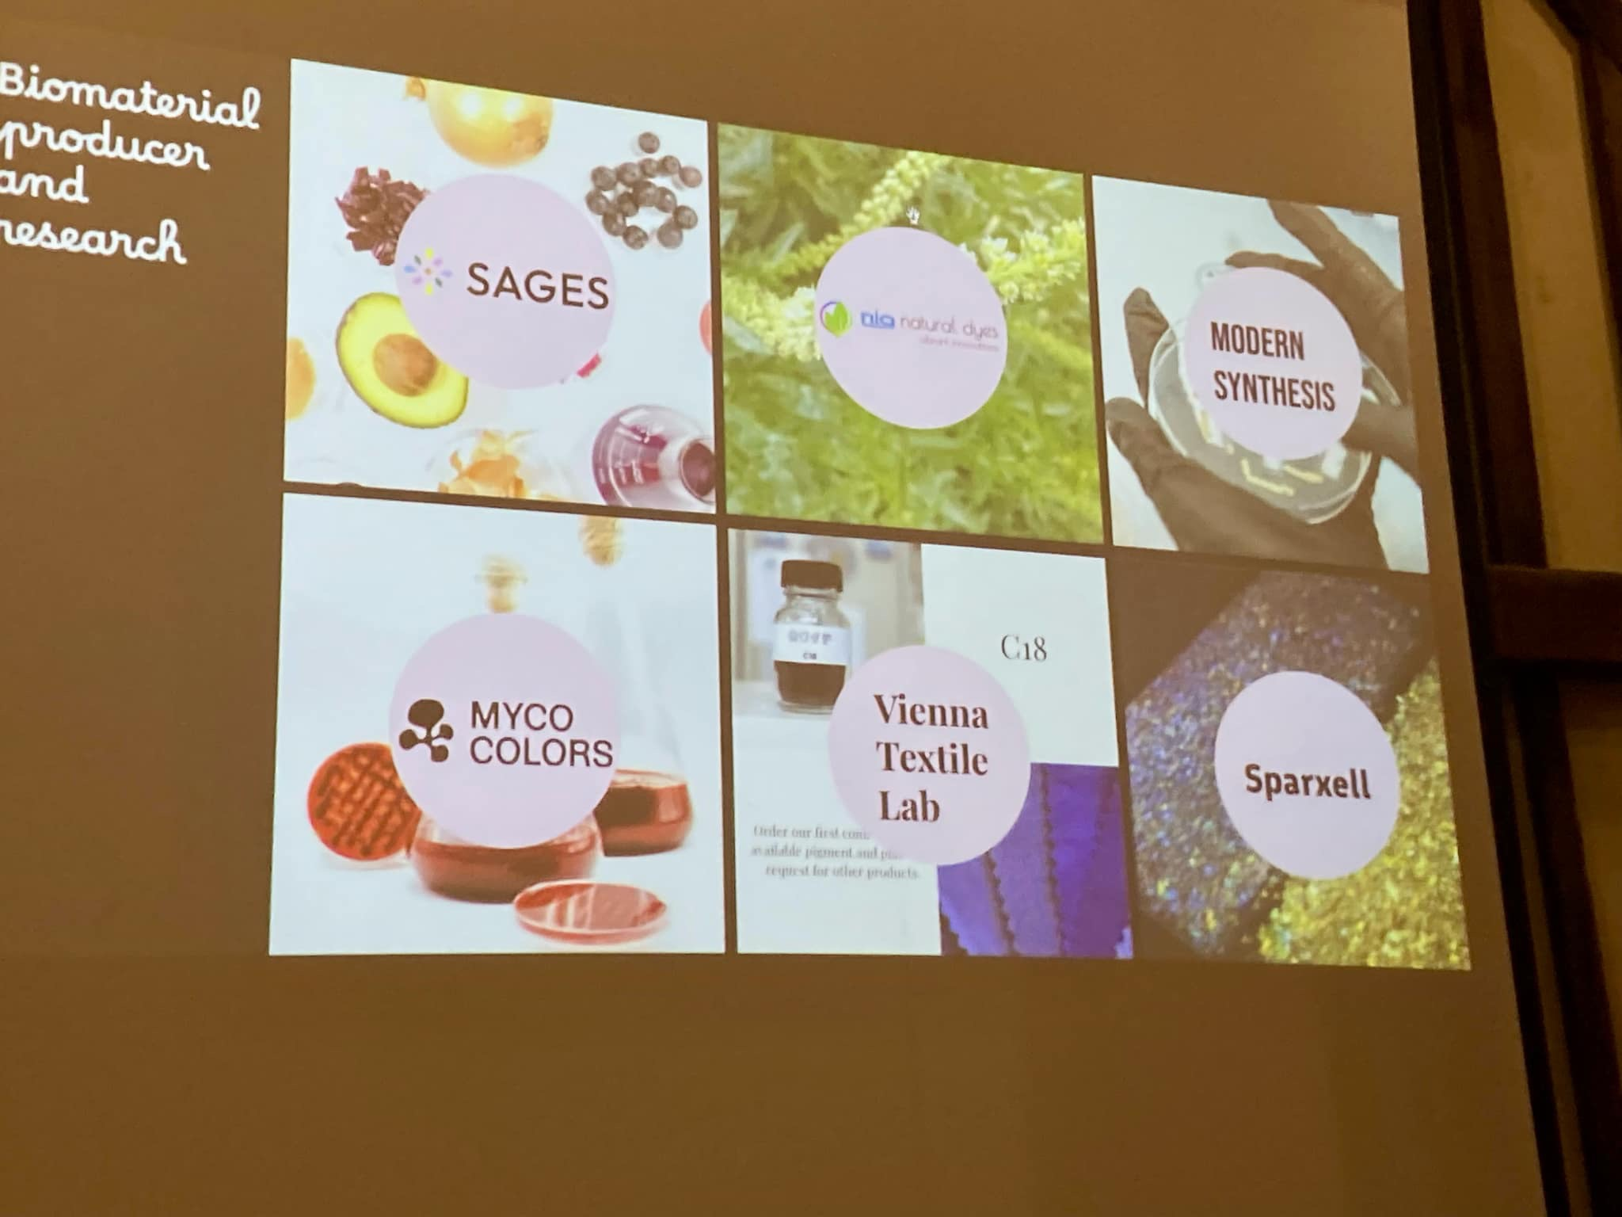
Beach of Dreams

